Slide 1
Module 8: Resource Management and Monitoring

Slide 2
Importance
Although the VMkernel works proactively to avoid resource contention, maximizing performance requires both analysis and ongoing monitoring. Developing skills in resource management, you can dynamically reallocate resources so that you can use available capacity more efficiently.

Slide 3
Module Lessons
Virtual CPU and Memory Concepts
Resource Controls
Resource Monitoring Tools
Monitoring Resource Use
Using Alarms

Slide 4
Virtual Beans: Resource Management and Monitoring
Virtual Beans wants to proactively manage and monitor its vSphere environment.
Virtual Beans administrators must be able to:
Increase allocation of CPU and memory resources for business-critical workloads, particularly during peak months.
Monitor VM performance to troubleshoot user problems.
Monitor ESXi host performance to avoid potential problems in the infrastructure.
Create monthly reports, for management, that contain graphs of VM resource usage.
Set notifications for when ESXi hosts experience high resource use.
As a Virtual Beans administrator, you must use the available tools in vSphere for managing and monitoring the vSphere environment.

Slide 5

Lesson 1: Virtual CPU and Memory Concepts

Slide 6
Learner Objectives
After completing this lesson, you should be able to meet the following objectives:
Describe CPU and memory concepts in relation to a virtualized environment
Recognize techniques for addressing memory resource overcommitment
Identify additional technologies that improve memory usage
Describe how VMware Virtual SMP works
Explain how the VMkernel uses hyperthreading

Slide 7
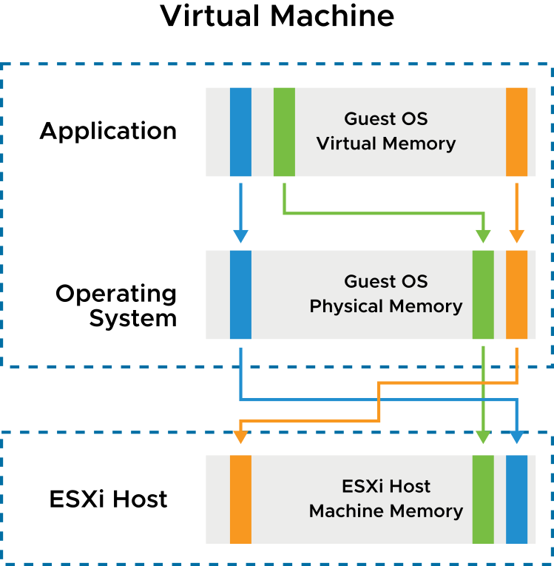
Memory Virtualization Basics
vSphere has the following layers of memory:
Guest OS virtual memory is presented to applications by the operating system.
Guest OS physical memory is presented to the virtual machine by the VMkernel.
Host machine memory that is managed by the VMkernel provides a contiguous, addressable memory space that is used by the VM.
Notes:
When running a virtual machine, the VMkernel creates a contiguous addressable memory space for the VM. This memory space has the same properties as the virtual memory address space presented to applications by the guest operating system. This memory space allows the VMkernel to run multiple VMs simultaneously while protecting the memory of each VM from being accessed by others. From the perspective of an application running in the VM, the VMkernel adds an extra level of address translation that maps the guest physical address to the host physical address.

Slide 8
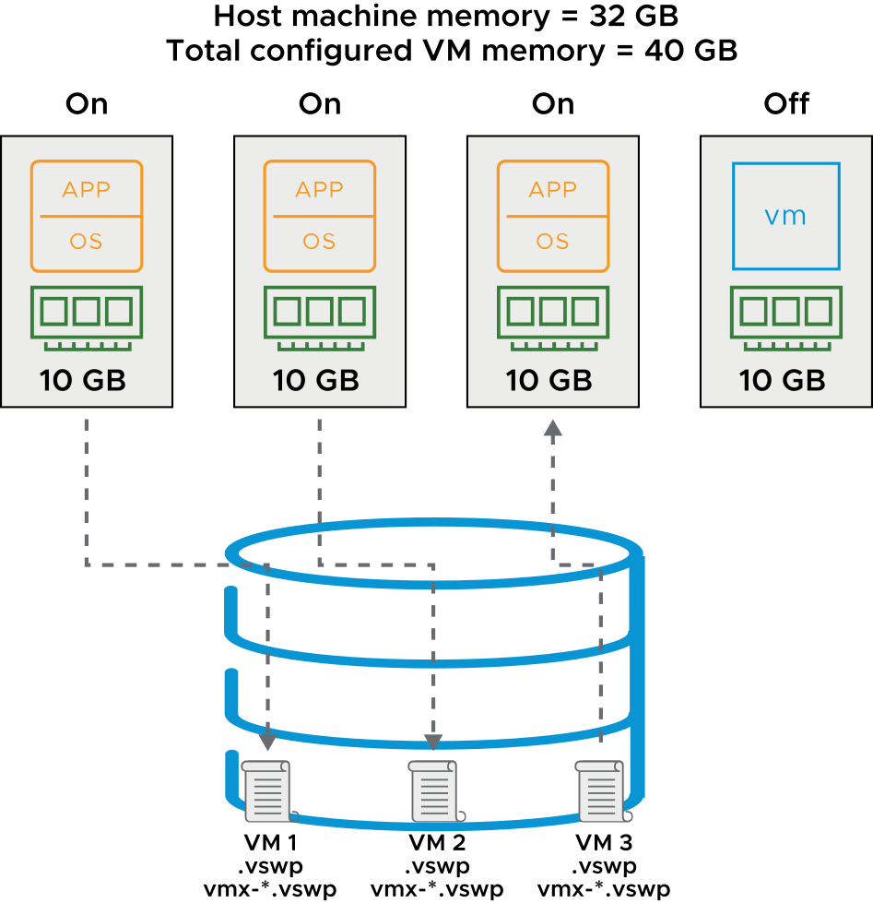
VM Memory Overcommitment
Memory is overcommitted when the combined configured memory footprint of all powered-on VMs exceeds that of the host memory sizes.
When memory is overcommitted:
VMs do not always use their full allocated memory.
To improve memory usage, an ESXi host transfers memory from idle VMs to VMs that need more memory.
Overcommitted memory is stored in the .vswp file.
Memory overhead is stored in the vmx-*.vswp file.
Notes:
The total configured memory sizes of all VMs might exceed the amount of available physical memory on the host. However, this condition does not necessarily mean that memory is overcommitted. Memory is overcommitted when the working memory size of all VMs exceeds that of the ESXi host’s physical memory size.
Because of the memory management techniques used by the ESXi host, your VMs can use more virtual RAM than the available physical RAM on the host. For example, you can have a host with 32 GB of memory and run four VMs with 10 GB of memory each. In that case, the memory is overcommitted. If all four VMs are idle, the combined consumed memory is below 32 GB. However, if all VMs are actively consuming memory, then their memory footprint might exceed 32 GB and the ESXi host becomes overcommitted. An ESXi host can run out of memory if VMs consume all reservable memory in an overcommitted-memory environment. Although the powered-on VMs are not affected, a new VM might fail to power on because of lack of memory. Overcommitment makes sense because, typically, some VMs are lightly loaded whereas others are more heavily loaded, and relative activity levels vary over time.
Extra memory from a VM is gathered into a swap file with the .vswp extension. The memory overcommitment process on the host uses the vmx-*.vswp swap file to gather and track memory overhead. Memory from this file is swapped out to disk when host machine memory is overcommitted.

Slide 9
Memory Overcommit Techniques
An ESXi host uses memory overcommit techniques to allow the overcommitment of memory while possibly avoiding the need to page memory out to disk.
Methods Used by the ESXi Host | Details
Transparent page sharing | This method economizes the use of physical memory pages. In this method, pages with identical contents are stored only once.
Ballooning | This method uses the VMware Tools balloon driver to deallocate memory from one VM to another. The ballooning mechanism becomes active when memory is scarce, forcing VMs to use their own paging areas.
Memory compression | This method tries to reclaim some memory performance when memory contention is high.
Host-level SSD swapping | Use of a solid-state drive on the ESXi host for a host cache swap file might increase performance.
VM memory paging to disk | Using VMkernel swap space is the last resort because of poor performance.
Notes:
The VMkernel uses various techniques to dynamically reduce the amount of physical RAM that is required for each VM. Each technique is described in the order that the VMkernel uses it:
Page sharing: ESXi can use a proprietary technique to transparently share memory pages between VMs, eliminating redundant copies of memory pages. Although pages are shared by default within VMs, as of vSphere 6.0, pages are no longer shared by default among VMs.
Ballooning: If the host memory begins to get low and the VM's memory use approaches its memory target, ESXi uses ballooning to reduce that VM's memory demands. Using the VMware-supplied vmmemctl module installed in the guest operating system as part of VMware Tools, ESXi can cause the guest operating system to relinquish the memory pages it considers least valuable. Ballooning provides performance closely matching that of a native system under similar memory constraints. To use ballooning, the guest operating system must be configured with sufficient swap space.
Memory compression: If the VM's memory use approaches the level at which host-level swapping is required, ESXi uses memory compression to reduce the number of memory pages that it must swap out. Because the decompression latency is much smaller than the swap-in latency, compressing memory pages has significantly less impact on performance than swapping out those pages.
Swap to host cache: Host swap cache is an optional memory reclamation technique that uses local flash storage to cache a virtual machine’s memory pages. By using local flash storage, the virtual machine avoids the latency associated with a storage network that might be used if it swapped memory pages to the virtual swap (.vswp) file.
Regular host-level swapping: When memory pressure is severe and the hypervisor must swap memory pages to disk, the hypervisor swaps to a host swap cache rather than to a .vswp file. When a host runs out of space on the host cache, a virtual machine’s cached memory is migrated to a virtual machine’s regular .vswp file. Each host must have its own host swap cache configured.

Slide 10
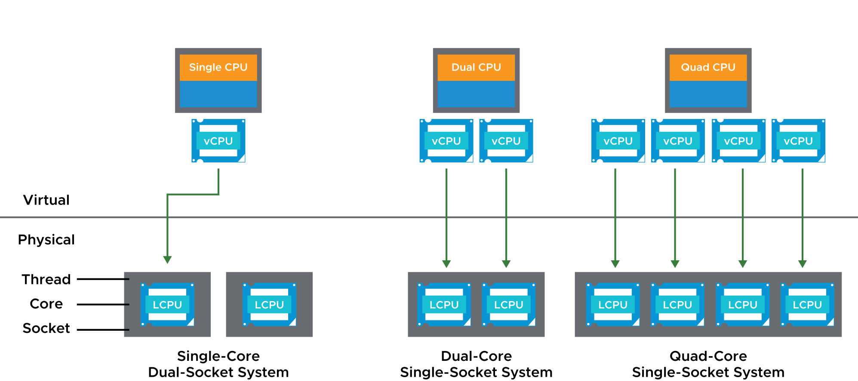
Configuring Multicore VMs
You can build VMs with multiple virtual CPUs (vCPUs). The number of vCPUs that you configure for a single VM depends on the physical architecture of the ESXi host.
Notes:
You can configure a VM with up to 256 virtual CPUs (vCPUs). The VMkernel includes a CPU scheduler that dynamically schedules vCPUs on the physical CPUs of the host system.
The VMkernel scheduler considers socket-core-thread topology when making scheduling decisions. Intel and AMD processors combine multiple processor cores into a single integrated circuit, called a socket in this discussion. A socket is a single package with one or more physical CPUs. Each core has one or more logical CPUs (LCPU in the diagram) or threads. With logical CPUs, the core can schedule one thread of execution. On the slide, the first system is a single-core, dual-socket system with two cores and, therefore, two logical CPUs.
When a vCPU of a single-vCPU or multi-vCPU VM must be scheduled, the VMkernel maps the vCPU to an available logical processor.
In addition to the physical host configuration, the number of vCPUs configured for a VM also depends on the guest operating system, the applications, and the specific use case for the VM itself.

Slide 11
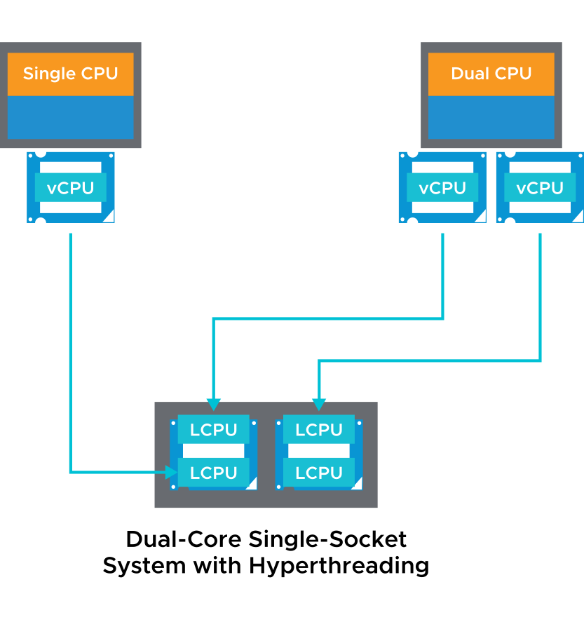
About Hyperthreading
With hyperthreading, a core can execute two threads or sets of instructions at the same time.
Hyperthreading provides more scheduler throughput.
Hyperthreading is enabled by default.
To enable hyperthreading:
Verify that the host system supports hyperthreading.
Enable hyperthreading in the system BIOS.
Ensure that hyperthreading for the ESXi host is turned on.
Notes:
If hyperthreading is enabled, ESXi can schedule two threads at the same time on each processor core (physical CPU). Hyperthreading provides more scheduler throughput. That is, hyperthreading provides more logical CPUs on which vCPUs can be scheduled. The drawback of hyperthreading is that it does not double the power of a core. So, if both threads of execution need the same on-chip resources at the same time, one thread has to wait. Still, on systems that use hyperthreading technology, performance is improved.
An ESXi host that is enabled for hyperthreading should behave almost exactly like a standard system. Logical processors on the same core have adjacent CPU numbers. Logical processors 0 and 1 are on the first core, logical processors 2 and 3 are on the second core, and so on.
Consult the host system hardware documentation to verify whether the BIOS includes support for hyperthreading. Then, enable hyperthreading in the system BIOS. Some manufacturers call this option Logical Processor and others call it Enable Hyperthreading.
Use the vSphere Client to ensure that hyperthreading for your host is turned on. To access the hyperthreading option, go to the host’s Summary tab and select CPUs under Hardware.

Slide 12
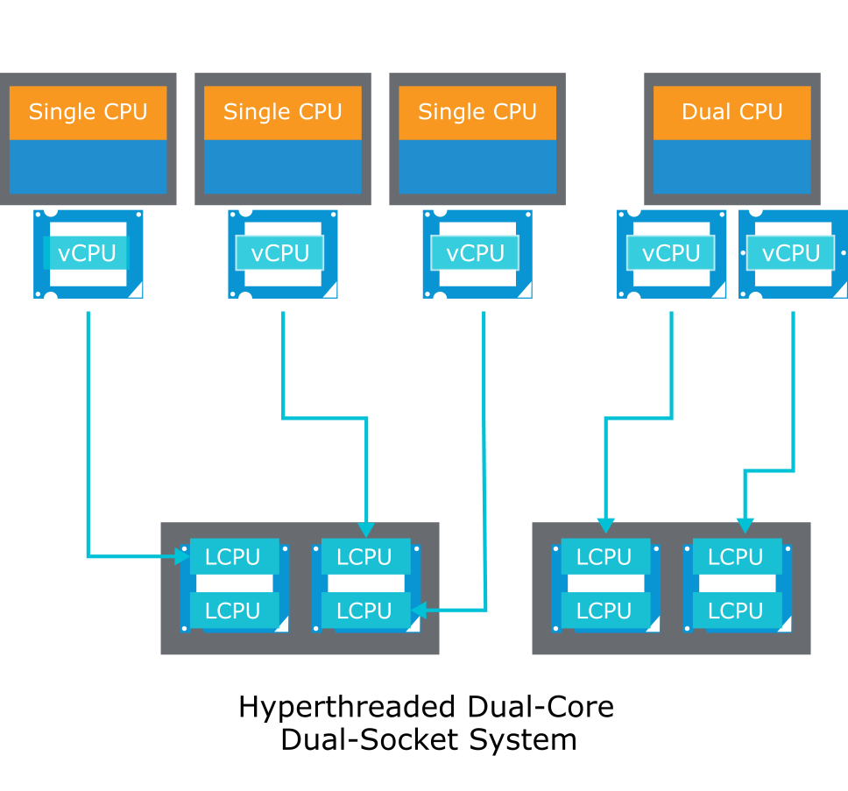
CPU Load Balancing
The VMkernel balances processor time to guarantee that the load is spread smoothly across processor cores in the system.
Notes:
The CPU scheduler can use each logical processor independently to execute VMs, providing capabilities that are similar to traditional symmetric multiprocessing (SMP) systems. The VMkernel intelligently manages processor time to guarantee that the load is spread smoothly across processor cores in the system. Every 2 milliseconds to 40 milliseconds (depending on the socket-core-thread topology), the VMkernel seeks to migrate vCPUs from one logical processor to another to keep the load balanced. The VMkernel does its best to schedule VMs with multiple vCPUs on two different cores rather than on two logical processors on the same core. But, if necessary, the VMkernel can map two vCPUs from the same VM to threads on the same core.
If a logical processor has no work, it is put into a halted state. This action frees its execution resources, and the VM running on the other logical processor on the same core can use the full execution resources of the core. Because the VMkernel scheduler accounts for this halt time, a VM running with the full resources of a core is charged more than a VM running on a half core. This approach to processor management ensures that the server does not violate the ESXi resource allocation rules.

Slide 13
Review of Learner Objectives
After completing this lesson, you should be able to meet the following objectives:
Describe CPU and memory concepts in relation to a virtualized environment
Recognize techniques for addressing memory resource overcommitment
Identify additional technologies that improve memory usage
Describe how VMware Virtual SMP works
Explain how the VMkernel uses hyperthreading

Slide 14
Lesson 2: Resource Controls

Slide 15
Learner Objectives
After completing this lesson, you should be able to meet the following objectives:
Assign share values for CPU and memory resources
Describe how virtual machines compete for resources
Define CPU and memory reservations and limits

Slide 16
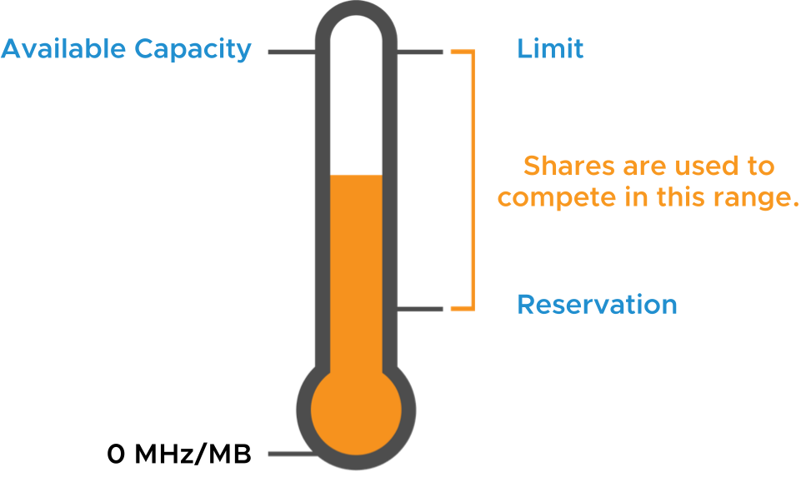
Reservations, Limits, and Shares
Beyond the CPU and memory configured for a VM, you can apply resource allocation settings to a VM to control the amount of resources granted:
A reservation specifies the guaranteed minimum allocation for a VM.
A limit specifies an upper bound for CPU or memory that can be allocated to a VM.
A share is a value that specifies the relative priority or importance of a VM's access to a given resource.
Notes:
Because VMs simultaneously use the resources of an ESXi host, resource contention can occur.
To manage resources efficiently, vSphere provides mechanisms to allow less, more, or an equal amount of access to a defined resource. vSphere also prevents a VM from consuming large amounts of a resource. vSphere grants a guaranteed amount of a resource to a VM whose performance is not adequate or that requires a certain amount of a resource to run properly.
When host memory or CPU is overcommitted, a VM’s allocation target is somewhere between its specified reservation and specified limit, depending on the VM’s shares and the system load. vSphere uses a share-based allocation algorithm to achieve efficient resource use for all VMs and to guarantee a given resource to the VMs that need it most.

Slide 17
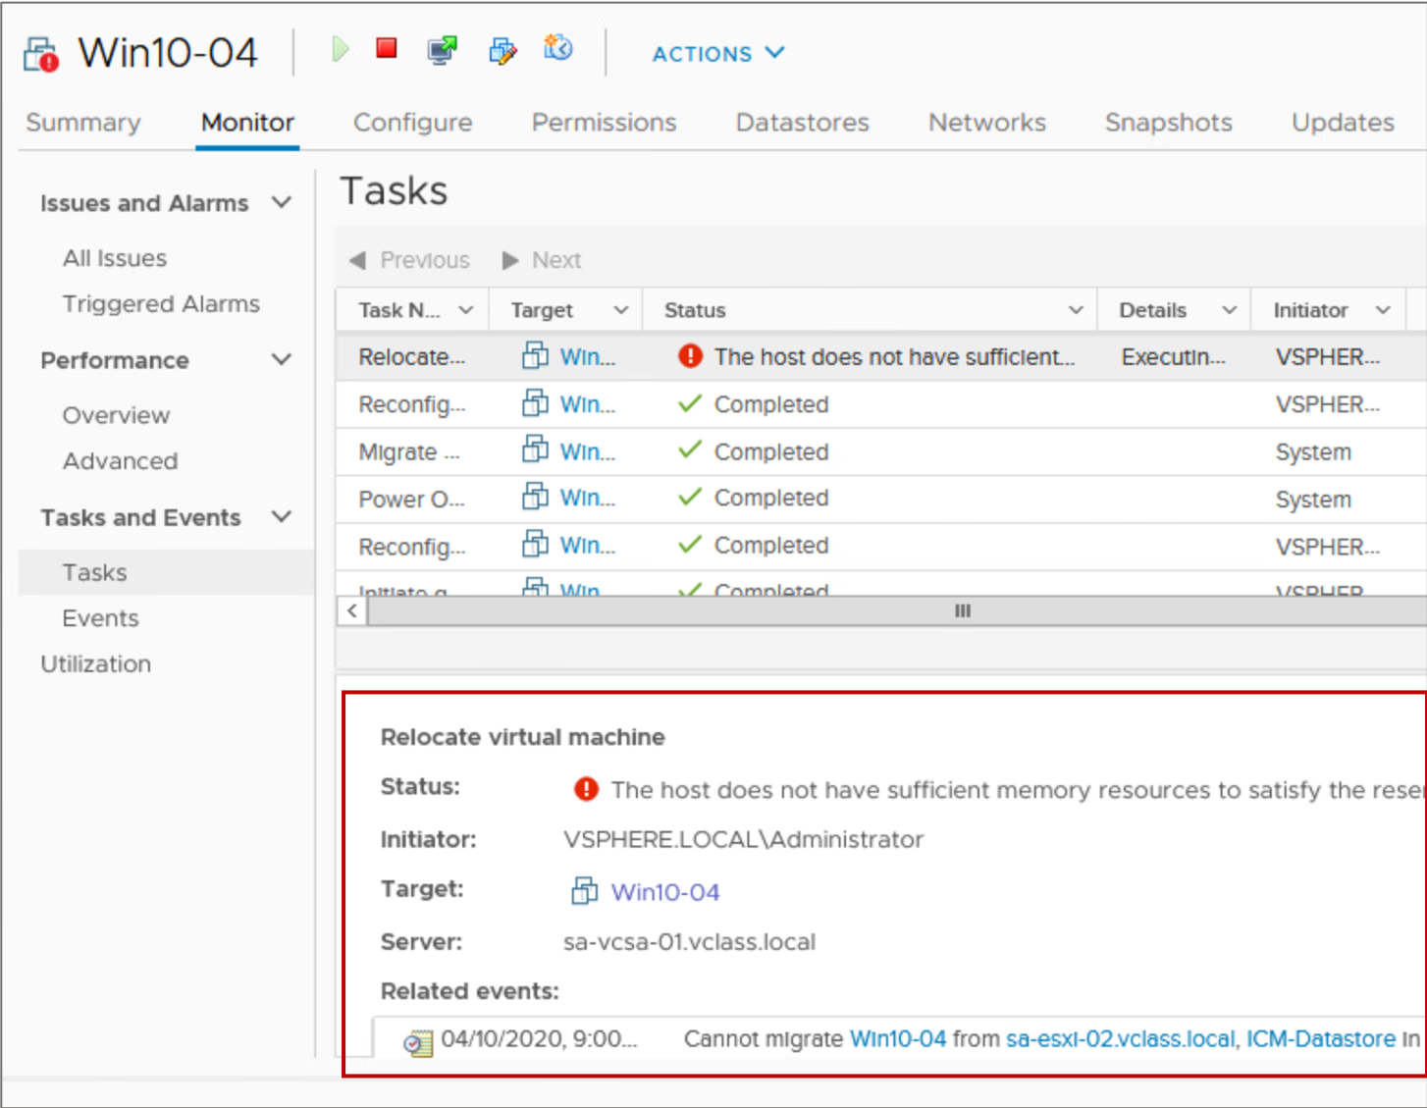
Resource Allocation Reservations: RAM
RAM reservations:
Memory reserved to a VM is guaranteed never to swap or balloon.
If an ESXi host does not have enough unreserved RAM to support a VM with a reservation, the VM does not power on.
Reservations are measured in MB, GB, or TB.
The default is 0 MB.
Adding a vSphere DirectPath I/O device to a VM sets memory reservation to the memory size of the VM.
Notes:
When configuring a memory reservation for a VM, you can specify the VM's configured amount of memory to reserve all of the VM's memory. For example, if a VM is configured with 4 GB of memory, you can set a memory reservation of 4 GB for the VM. You might configure such a memory reservation for a critical VM that must maintain a high level of performance.
Alternatively, you can select the Reserve All Guest Memory (All locked) check box. Selecting this check box ensures that all of the VM's memory gets reserved even if you change the total amount of memory for the VM. The memory reservation is immediately readjusted when the VM's memory configuration changes.

Slide 18
Resource Allocation Reservations: CPU
CPU reservations:
CPU that is reserved for a VM is guaranteed to be immediately scheduled on physical cores. The VM is never placed in a CPU ready state.
If an ESXi host does not have enough unreserved CPU to support a VM with a reservation, the VM does not power on.
Reservations are measured in MHz or GHz.
The default is 0 MHz.

Slide 19
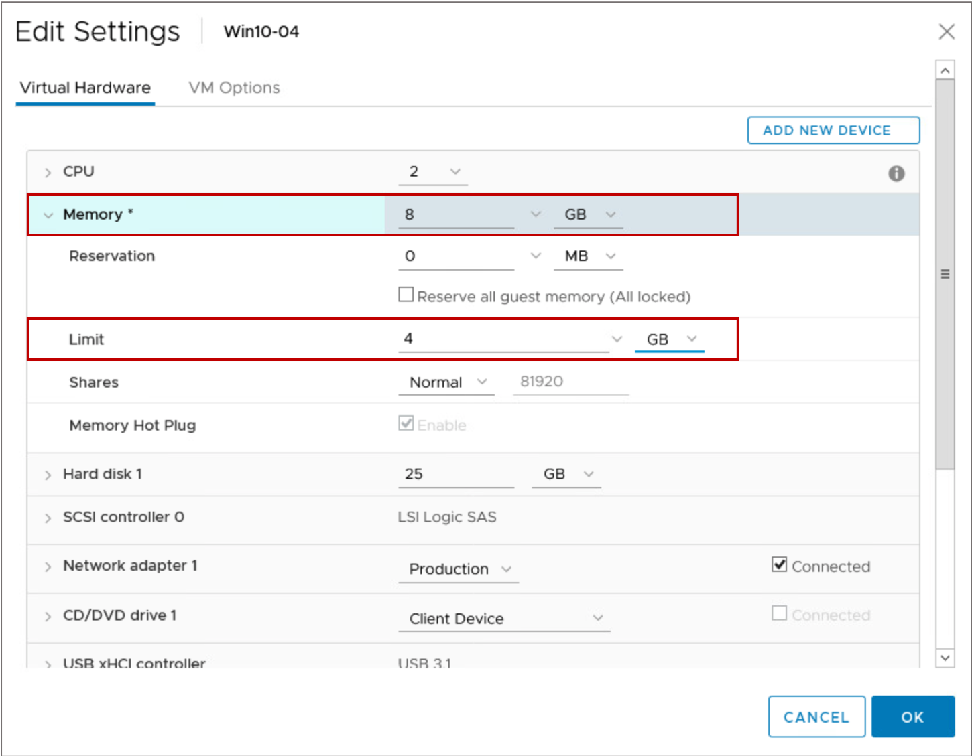
Resource Allocation Limits
RAM limits:
VMs never consume more physical RAM than is specified by the memory allocation limit.
VMs might use the VM swap mechanism (.vswp) if the guest OS attempts to consume more RAM than is specified by the limit.
CPU limits:
VMs never consume more physical CPU than is specified by the CPU allocation limit.
CPU threads are placed in a ready state if the guest OS attempts to schedule threads faster than the limit allows.
Usually, specifying a limit is not necessary.
Notes:
Specifying limits has the following benefits and drawbacks:
Benefits: Assigning a limit is useful if you start with a few VMs and want to manage user expectations. The performance deteriorates as you add more VMs. You can simulate having fewer resources available by specifying a limit.
Drawbacks: You might waste idle resources if you specify a limit. The system does not allow VMs to use more resources than the limit, even when the system is underused and idle resources are available. Specify the limit only if you have good reasons for doing so.

Slide 20
Resource Allocation Shares
Shares define the relative importance of a VM:
If a VM has twice as many shares of a resource as another VM, the VM is entitled to consume twice as much of that resource when these two VMs compete for resources.
Share values apply only if an ESXi host experiences contention for a resource.
You can set shares to high, normal, or low. You can also select the custom setting to assign a specific number of shares to each VM.
Setting | CPU Share Values | Memory Share Values
High | 2,000 shares per vCPU | 20 shares per MB of configured VM memory
Normal | 1,000 shares per vCPU | 10 shares per MB of configured VM memory
Low | 500 shares per vCPU | 5 shares per MB of configured VM memory
Notes:
High, normal, and low settings represent share values with a 4:2:1 ratio, respectively. A custom value of shares assigns a specific number of shares (which expresses a proportional weight) to each VM.

Slide 21
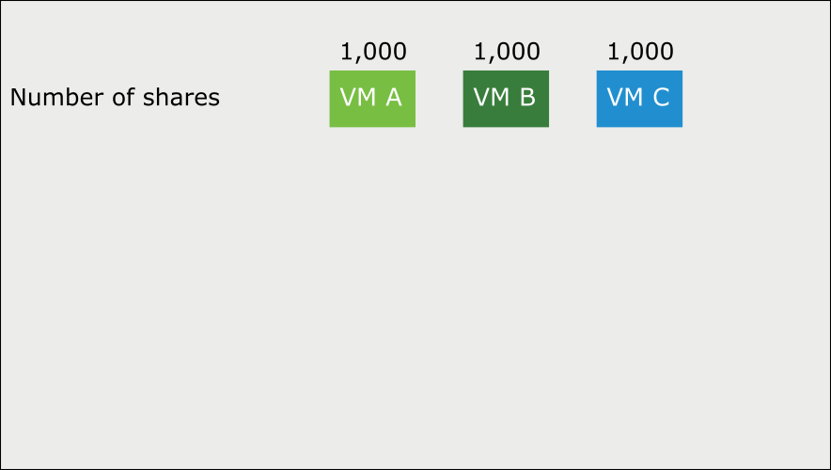
Resource Shares Example (1)
VMs are resource consumers. The default resource settings that you assign during VM creation work well for most VMs.
Notes:
The proportional share mechanism applies to CPU, memory, storage I/O, and network I/O allocation. The mechanism operates only when VMs contend for the same resource.

Slide 22
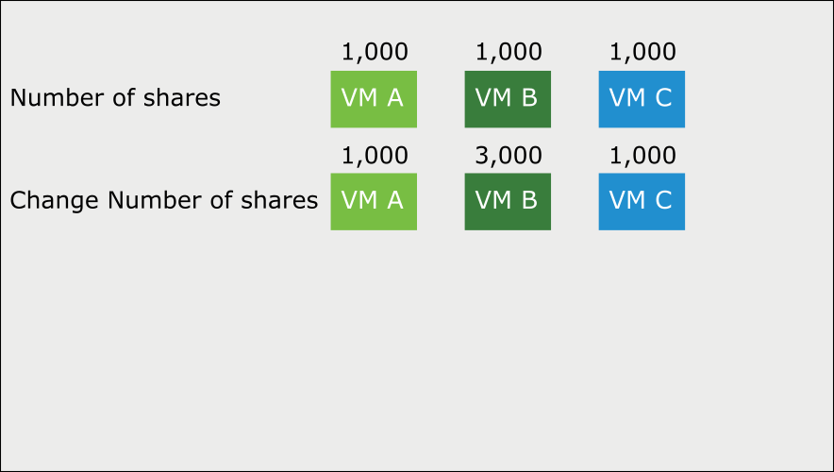
Resource Shares Example (2)
You can add shares to a virtual machine while it is running.
Notes:
You can add shares to a VM while it is running, and the VM gets more access to that resource (assuming competition for the resource). When you add a VM, it gets shares too. The VM’s share amount factors into the total number of shares, but existing VMs are guaranteed not to be starved for the resource.

Slide 23
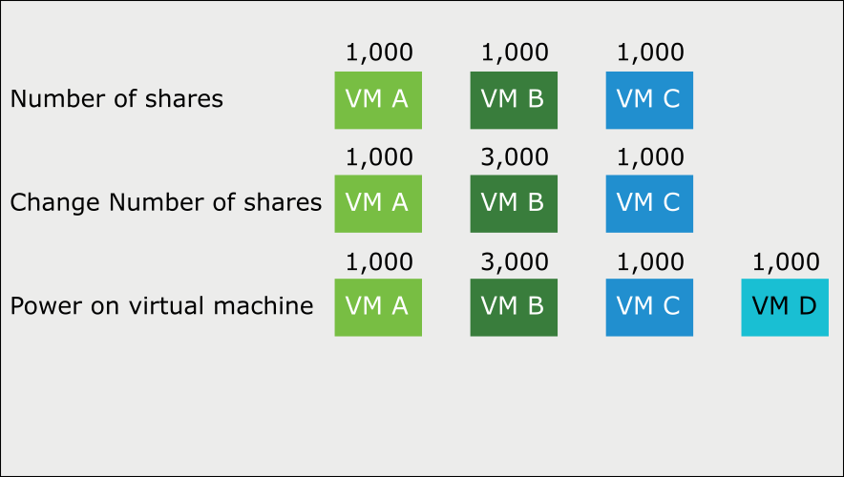
Resource Shares Example (3)
Shares guarantee that a VM is given a certain amount of a resource.
Notes:
Shares guarantee that a VM is given a certain amount of a resource (CPU, RAM, storage I/O, or network I/O).
For example, consider the third row of VMs on the slide:
VM D is powered on with 1,000 shares.
Before VM D was powered on, a total of 5,000 shares were available, but VM D’s addition increases the total shares to 6,000.
The result is that the other VMs' shares decline in value. But each VM’s share value still represents a minimum guarantee. VM A is still guaranteed one-sixth of the resource because it owns one-sixth of the shares.

Slide 24
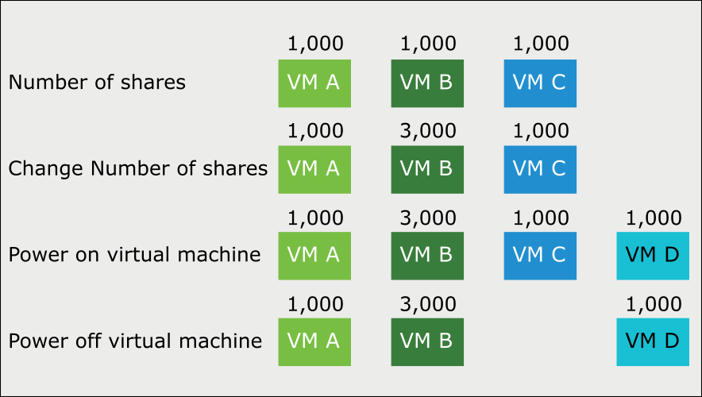
Resource Shares Example (4)
When you delete or power off a VM, fewer total shares remain, so the surviving VMs get more access.

Slide 25
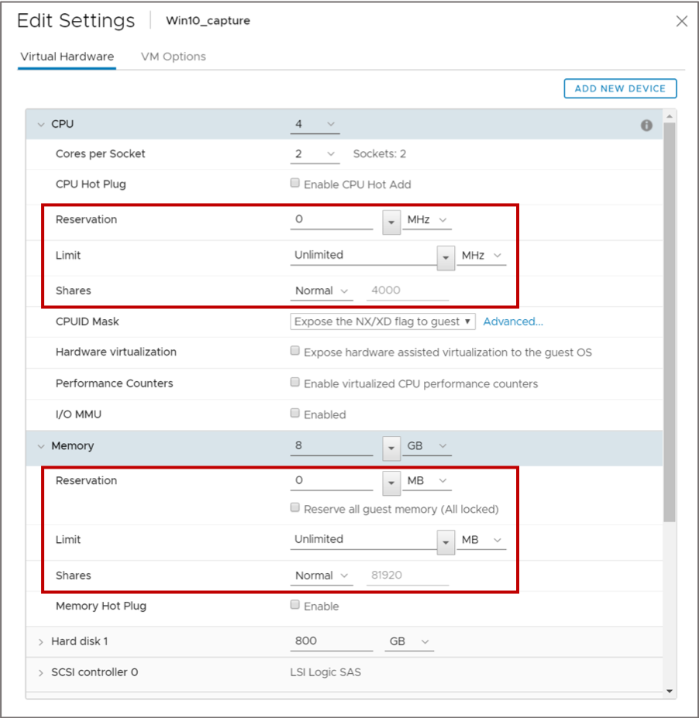
Defining Resource Allocation Settings for a VM
You can edit a VM's settings to configure CPU and memory resource allocations.

Slide 26
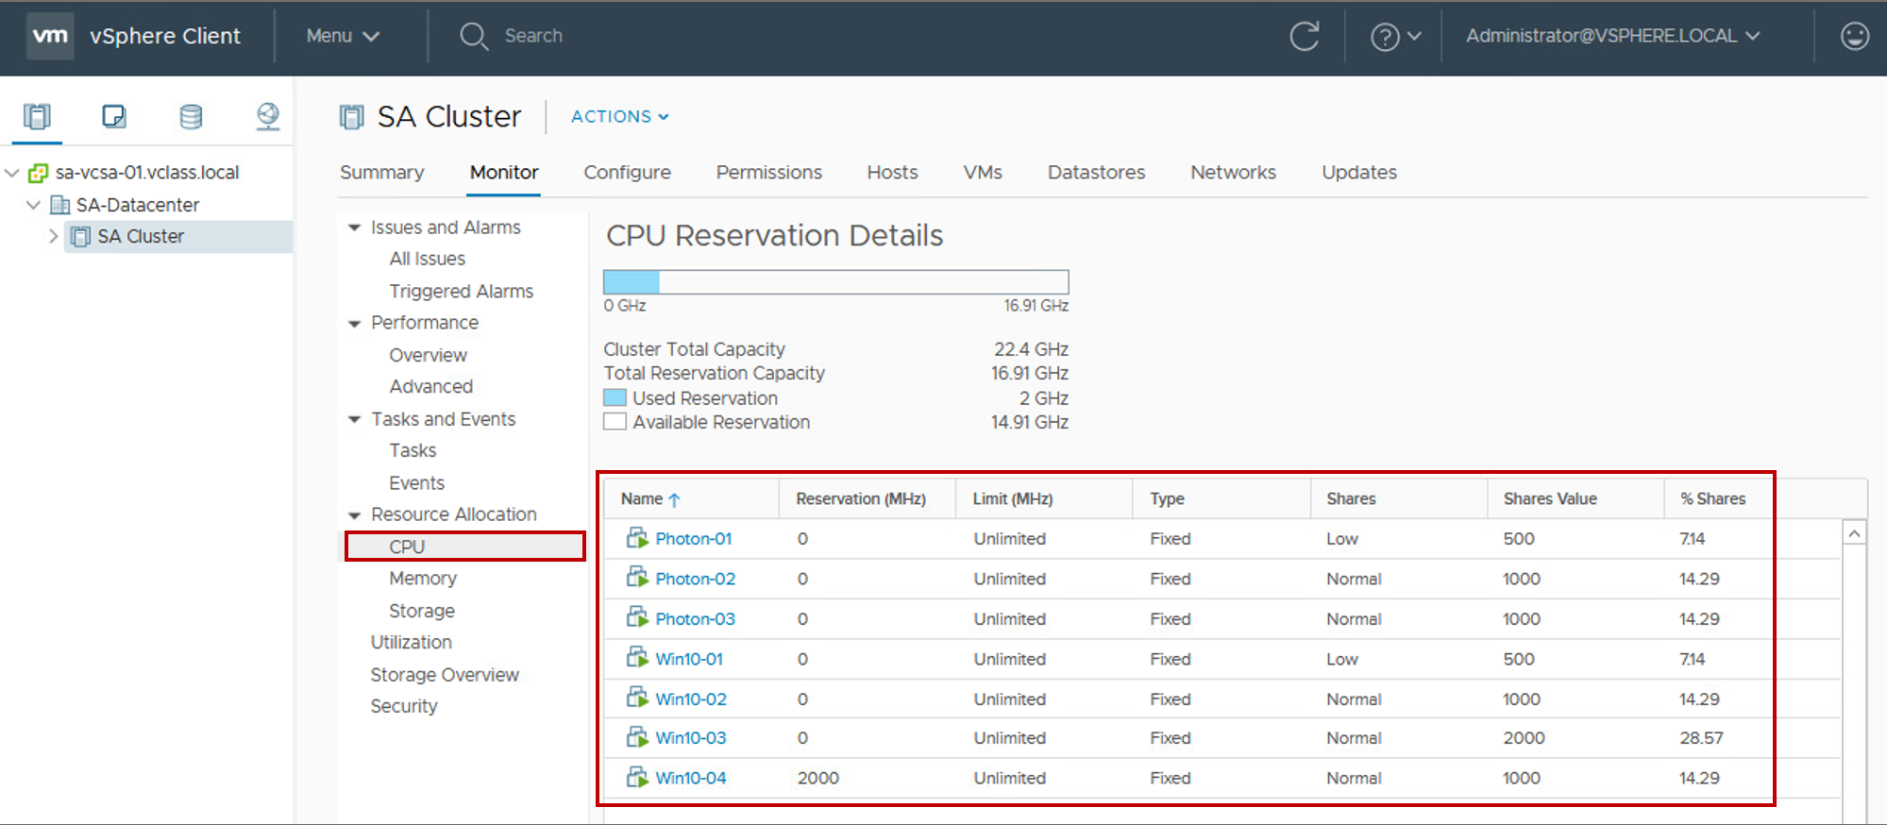
Viewing VM Resource Allocation Settings
You can view reservations, limits, and shares settings for all VMs in a cluster.

Slide 27
Lab 22: Controlling VM Resources
Control VM CPU resources using shares:
Create CPU Contention
Verify CPU Share Functionality

Slide 28
Review of Learner Objectives
After completing this lesson, you should be able to meet the following objectives:
Assign share values for CPU and memory resources
Describe how virtual machines compete for resources
Define CPU and memory reservations and limits

Slide 29
Lesson 3: Resource Monitoring Tools

Slide 30
Learner Objectives
After completing this lesson, you should be able to meet the following objectives:
Describe the performance-tuning methodology
Identify resource-monitoring tools
Use vCenter Server performance charts to view performance

Slide 31

Performance-Tuning Methodology
You can tune the performance of your vSphere environment:
Assess performance:
Use appropriate monitoring tools.
Record a numerical benchmark before changes.
Identify the limiting resource.
Make more resources available:
Allocate more resources.
Reduce competition.
Log your changes.
Benchmark again.
Notes:
The best practice for performance tuning is to take a logical step-by-step approach:
For a complete view of the performance situation of a VM, use monitoring tools in the guest operating system and in vCenter Server.
Identify the resource that the VM relies on the most. This resource is most likely to affect the VM’s performance if the VM is constrained by it.
Give a VM more resources or decrease the resources of other VMs.
After making more of the limiting resource available to the VM, take another benchmark and record changes.
Be cautious when making changes to production systems because a change might negatively affect the performance of the VMs.

Slide 32
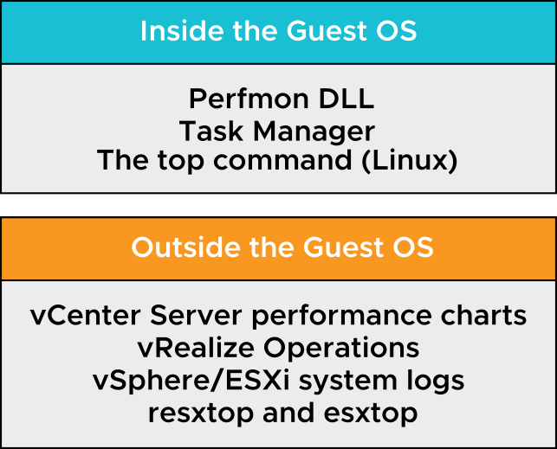
Resource-Monitoring Tools
Many resource-monitoring and performance-monitoring tools are available for use with vSphere.
Notes:
Tools in the guest operating system are available from sources external to VMware and are used in various VMware applications. Many tools used outside of the guest OS are made available by VMware for use with vSphere and other applications.
A partial list of these resource-monitoring tools is shown on the slide.

Slide 33
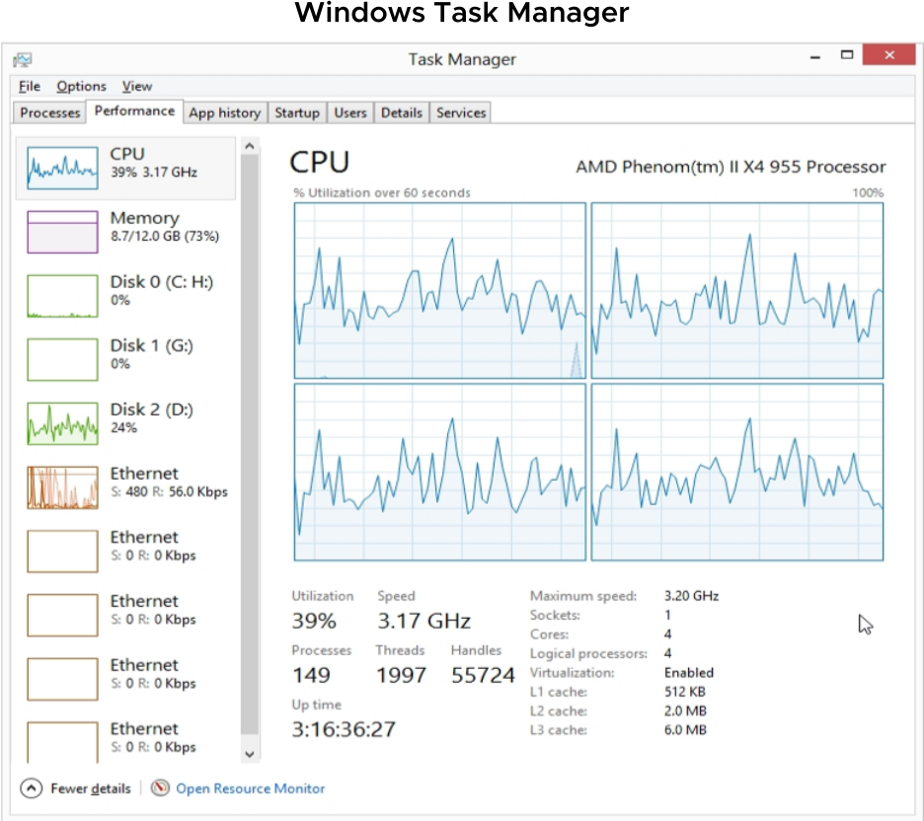
Guest Operating System Monitoring Tools
To monitor performance in the guest operating system, use tools that you are familiar with, such as Windows Task Manager.
Notes:
Windows Task Manager helps you measure CPU and memory use in the guest operating system.
The measurements that you take with tools in the guest operating system reflect resource usage of the guest operating system, not necessarily of the VM itself.

Slide 34
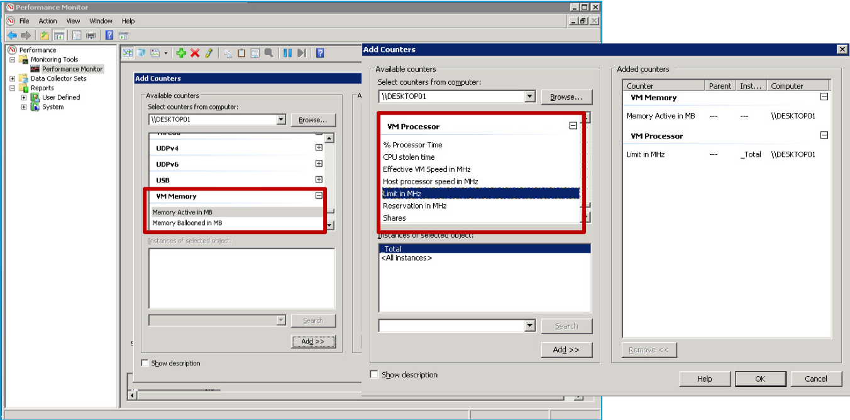
Using Perfmon to Monitor VM Resources
The Perfmon DLL in VMware Tools provides VM processor and memory objects for accessing host statistics in a VM.
Notes:
VMware Tools includes a library of functions called the Perfmon DLL. With Perfmon, you can access key host statistics in a guest VM. Using the Perfmon performance objects (VM Processor and VM Memory), you can view actual CPU and memory usage and observed CPU and memory usage of the guest operating system.
For example, you can use the VM Processor object to view the % Processor Time counter, which monitors the VM’s current virtual processor load. Likewise, you can use the Processor object and view the % Processor Time counter (not shown), which monitors the total use of the processor by all running processes.

Slide 35
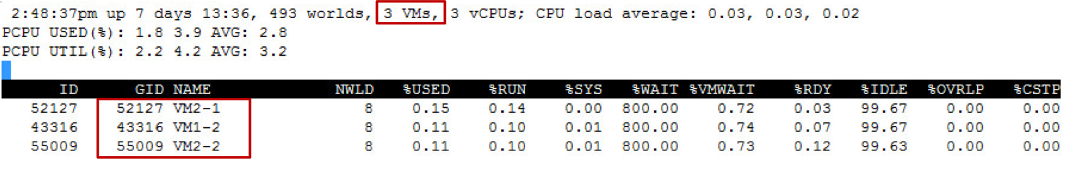
Using esxtop to Monitor VM Resources
The esxtop utility is the primary real-time performance monitoring tool for vSphere:
Can be run from the host’s local vSphere ESXi Shell as esxtop
Can be run remotely from vSphere CLI as resxtop
Works like the top performance utility in Linux operating systems
In this example, you enter lowercase c and uppercase V to view CPU metrics for VMs.
Notes:
You can run the esxtop utility by using vSphere ESXi Shell to communicate with the management interface of the ESXi host. You must have root user privileges.

Slide 36
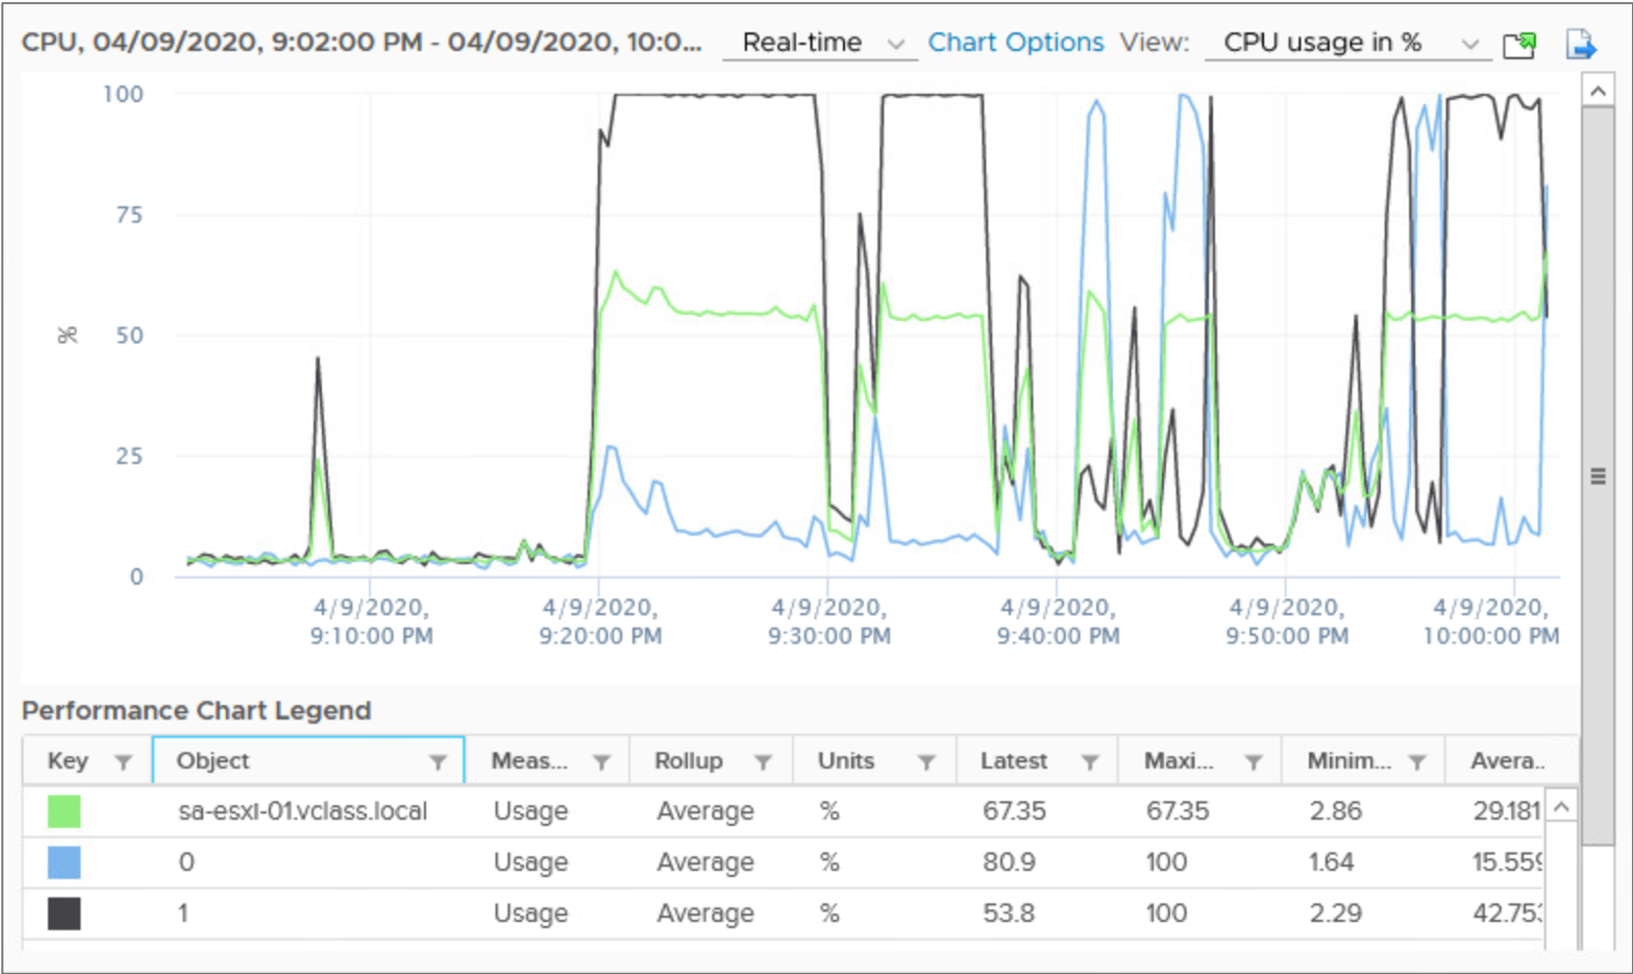
Monitoring Inventory Objects with Performance Charts
The vSphere statistics subsystem collects data on the resource usage of inventory objects, which include:
Clusters
Hosts
Datastores
Networks
Virtual machines
Notes:
Data on a wide range of metrics is collected at frequent intervals, processed, and archived in the vCenter Server database. You can access statistical information through command-line monitoring utilities or by viewing performance charts in the vSphere Client.

Slide 37
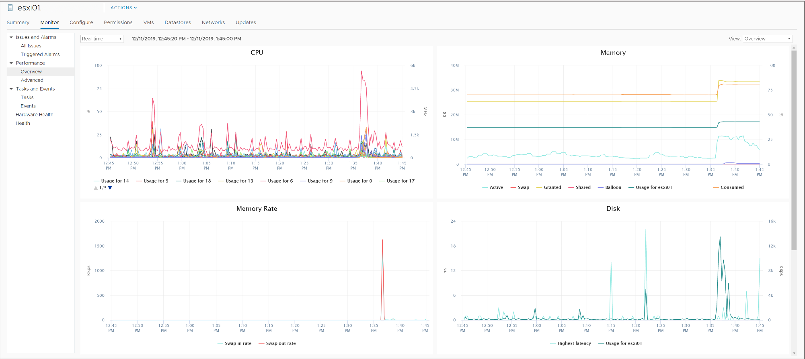
Working with Overview Performance Charts
The overview performance charts display the most common metrics for an object in the inventory.
Notes:
You can access overview and advanced performance charts in the vSphere Client.
Overview performance charts show the performance statistics that VMware considers most useful for monitoring performance and diagnosing problems.
Depending on the object that you select in the inventory, the performance charts provide a quick visual representation of how your host or VM is performing.

Slide 38
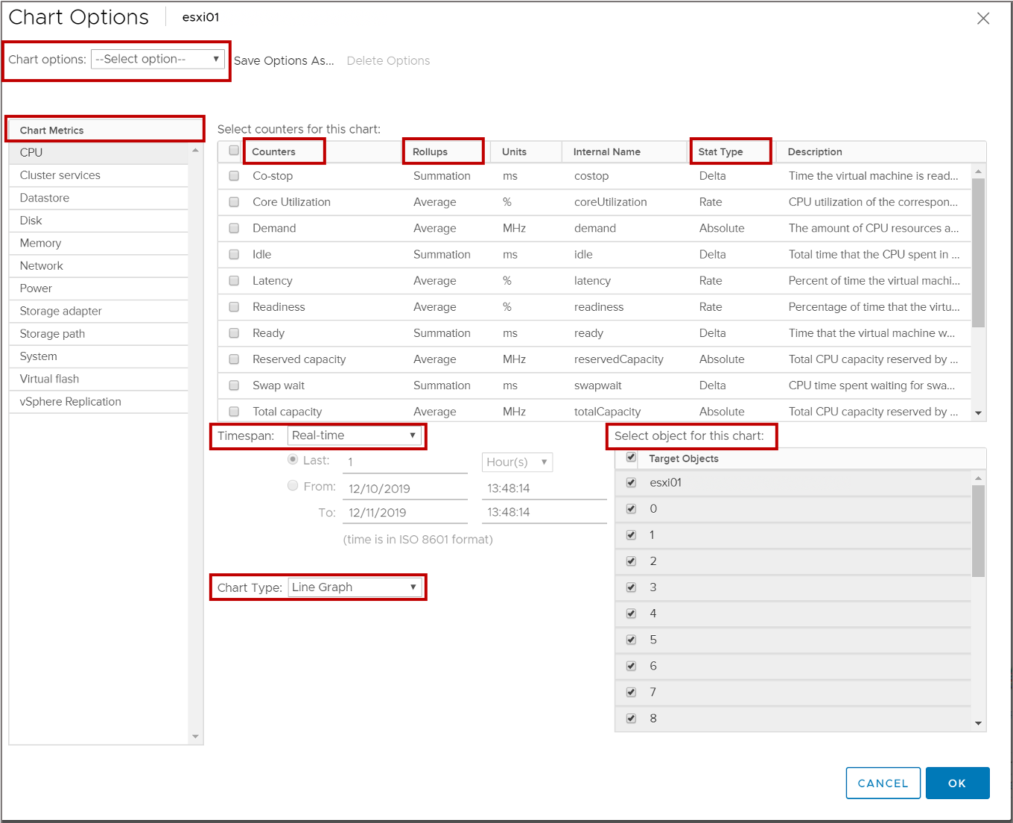
Working with Advanced Performance Charts
Advanced charts support data counters that are not supported in other performance charts.
Notes:
In the vSphere Client, you can customize the appearance of advanced performance charts.
Advanced charts have the following features:
More information than overview charts: Point to a data point in a chart to display details about that specific data point.
Customizable charts: Change chart settings. Save custom settings to create your own charts.
Save data to an image file or a spreadsheet.
To customize advanced performance charts, select Advanced under Performance. Click the Chart Options link in the Advanced Performance pane.

Slide 39
Chart Options: Real-Time and Historical
vCenter Server stores statistics at different specificities.
Time Interval | Data Frequency | Number of Samples
Real-time (past hour) | 20 seconds | 180
Past day | 5 minutes | 288
Past week | 30 minutes | 336
Past month | 2 hours | 360
Past year | 1 day | 365
Notes:
Real-time information is information that is generated for the past hour at 20-second intervals. Historical information is generated for the past day, week, month, or year, at varying specificities.
By default, vCenter Server has four archiving intervals: day, week, month, and year. Each interval specifies a length of time that statistics are archived in the vCenter Server database. You can configure which intervals are used and for what period of time. You can also configure the number of data counters that are used during a collection interval by setting the collection level. Together, the collection interval and the collection level determine how much statistical data is collected and stored in your vCenter Server database. For example, using the table, past-day statistics show one data point every 5 minutes, for a total of 288 samples. Past-year statistics show 1 data point per day, or 365 samples.
Real-time statistics are not stored in the database. They are stored in a flat file on ESXi hosts and in memory on vCenter Server instances. ESXi hosts collect real-time statistics only for the host or the VMs that are available on the host. Real-time statistics are collected directly on an ESXi host every 20 seconds. If you query for real-time statistics, vCenter Server queries each host directly for the data. vCenter Server does not process the data at this point. vCenter Server only passes the data to the vSphere Client.
On ESXi hosts, the statistics are kept for 30 minutes, after which 90 data points are collected. The data points are aggregated, processed, and returned to vCenter Server. vCenter Server then archives the data in the database as a data point for the day collection interval.
To ensure that performance is not impaired when collecting and writing the data to the database, cyclical queries are used to collect data counter statistics. The queries occur for a specified collection interval. At the end of each interval, the data calculation occurs.

Slide 40
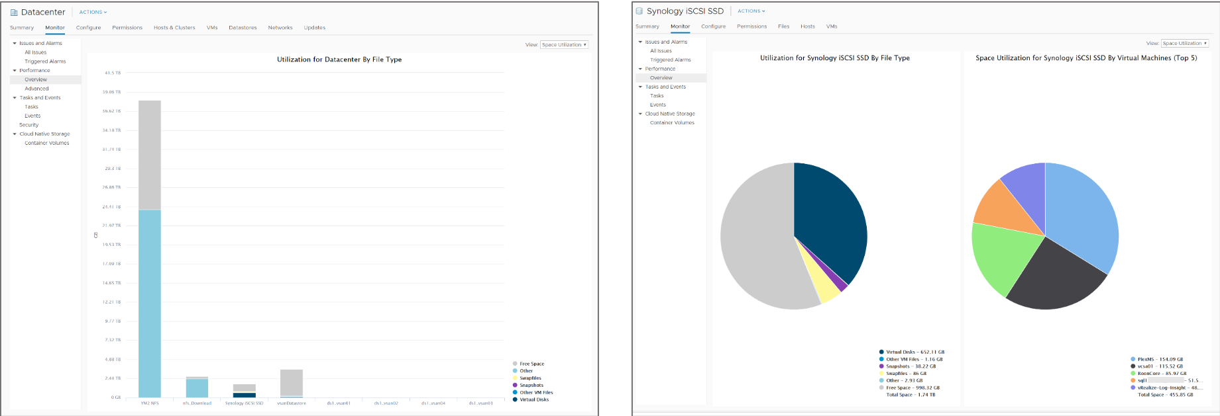
Chart Types: Bar and Pie
Depending on the metric type and object, performance metrics are displayed in different types of charts, such as bar charts and pie charts.
Notes:
Bar charts display storage metrics for datastores in a selected data center. Each datastore is represented as a bar in the chart. Each bar displays metrics based on the file type: virtual disks, other VM files, snapshots, swap files, and other files.
Pie charts display storage metrics for a single object, based on the file types or VMs. For example, a pie chart for a datastore can display the amount of storage space occupied by the VMs that take up the largest space.

Slide 41
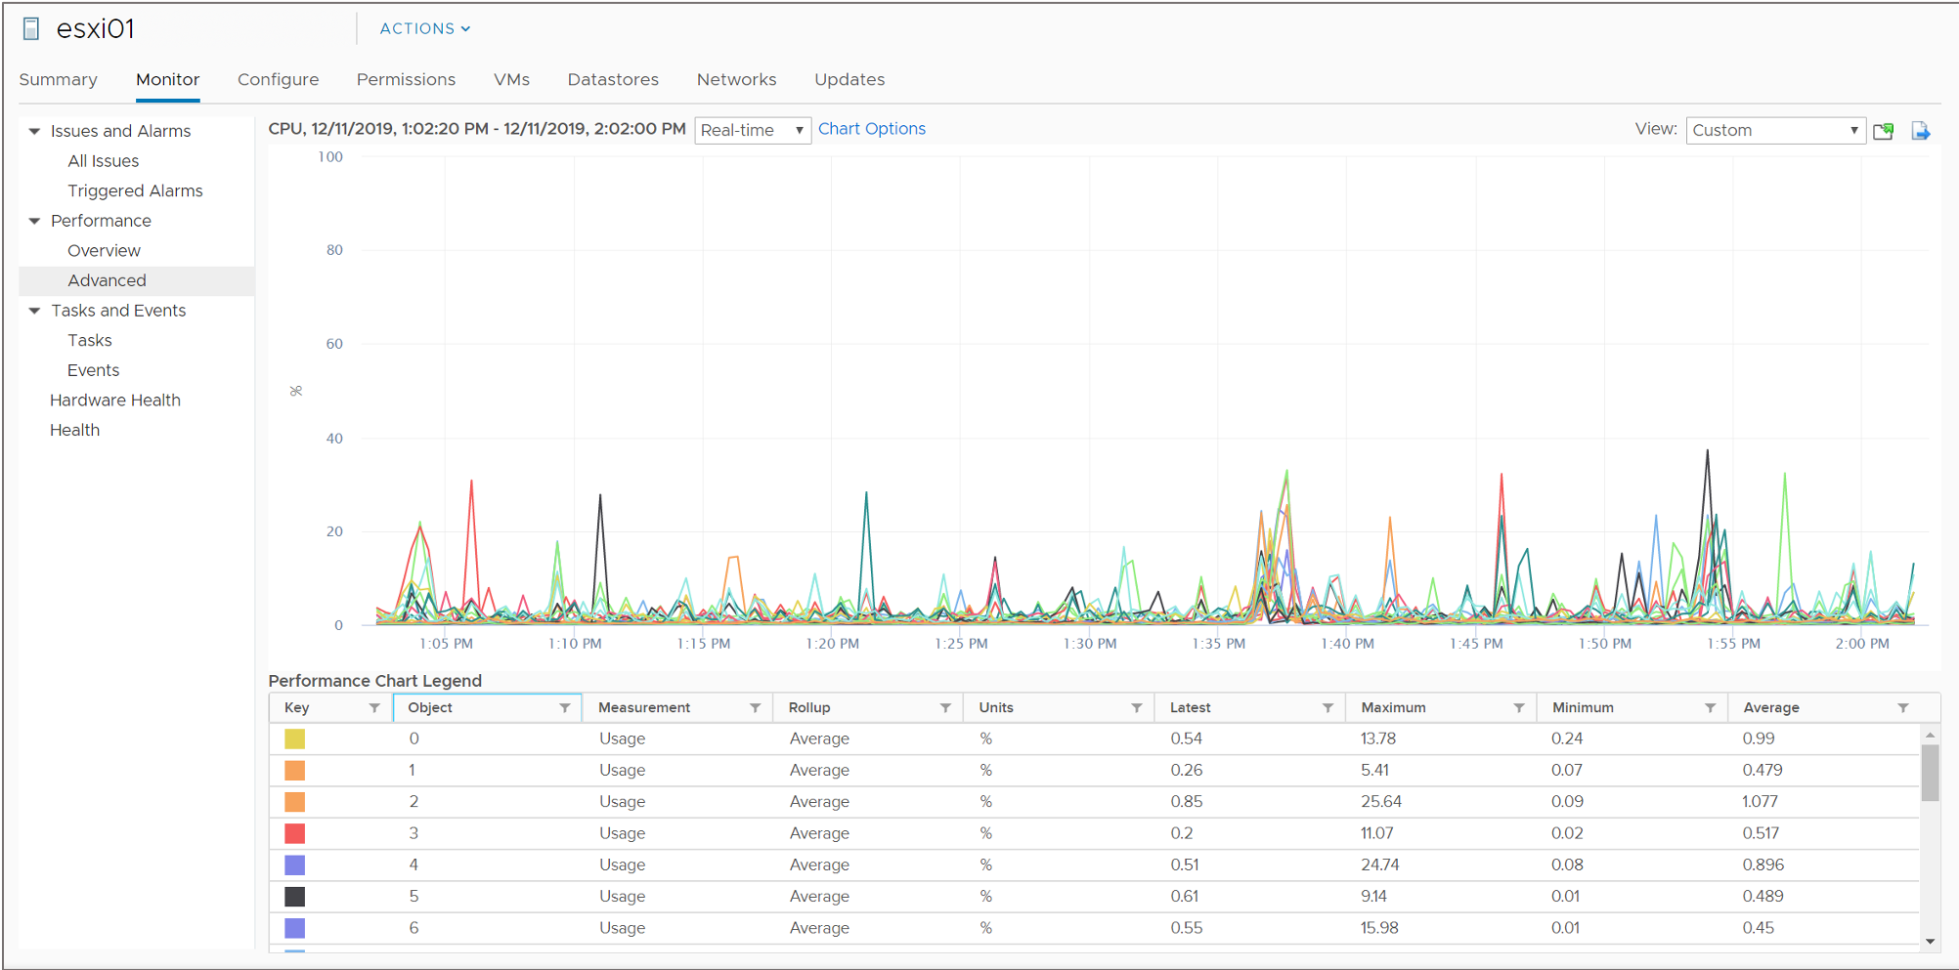
Chart Types: Line
A line chart displays metrics for a single inventory object, for example, metrics for each CPU on an ESXi host.
Notes:
In a line chart, the data for each performance counter is plotted on a separate line in the chart. For example, a CPU chart for a host can contain a line for each of the host's CPUs. Each line plots the CPU's usage over time.

Slide 42
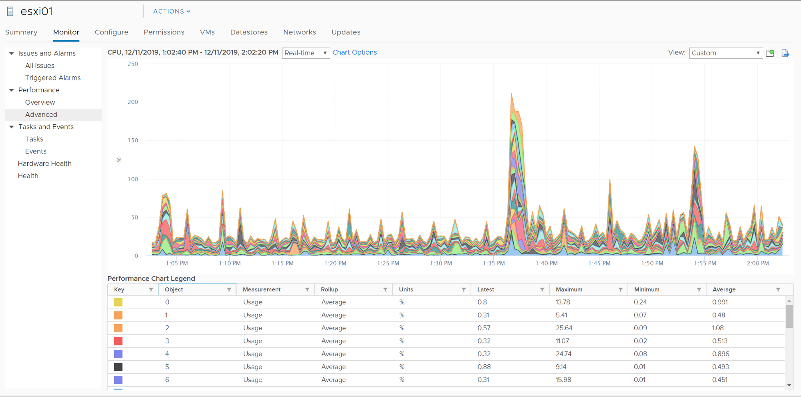
Chart Types: Stacked
Stacked charts are useful for comparing resource allocation and usage across multiple hosts or VMs.
Notes:
Stacked charts display metrics for the child objects that have the highest statistical values. All other objects are aggregated, and the sum value is displayed with the term Other. For example, a host’s stacked CPU usage chart displays CPU usage metrics for the five VMs on the host that are consuming the most CPU resources. The Other amount contains the total CPU usage of the remaining VMs. The metrics for the host itself are displayed in separate line charts. By default, the 10 child objects with the highest data counter values appear.

Slide 43
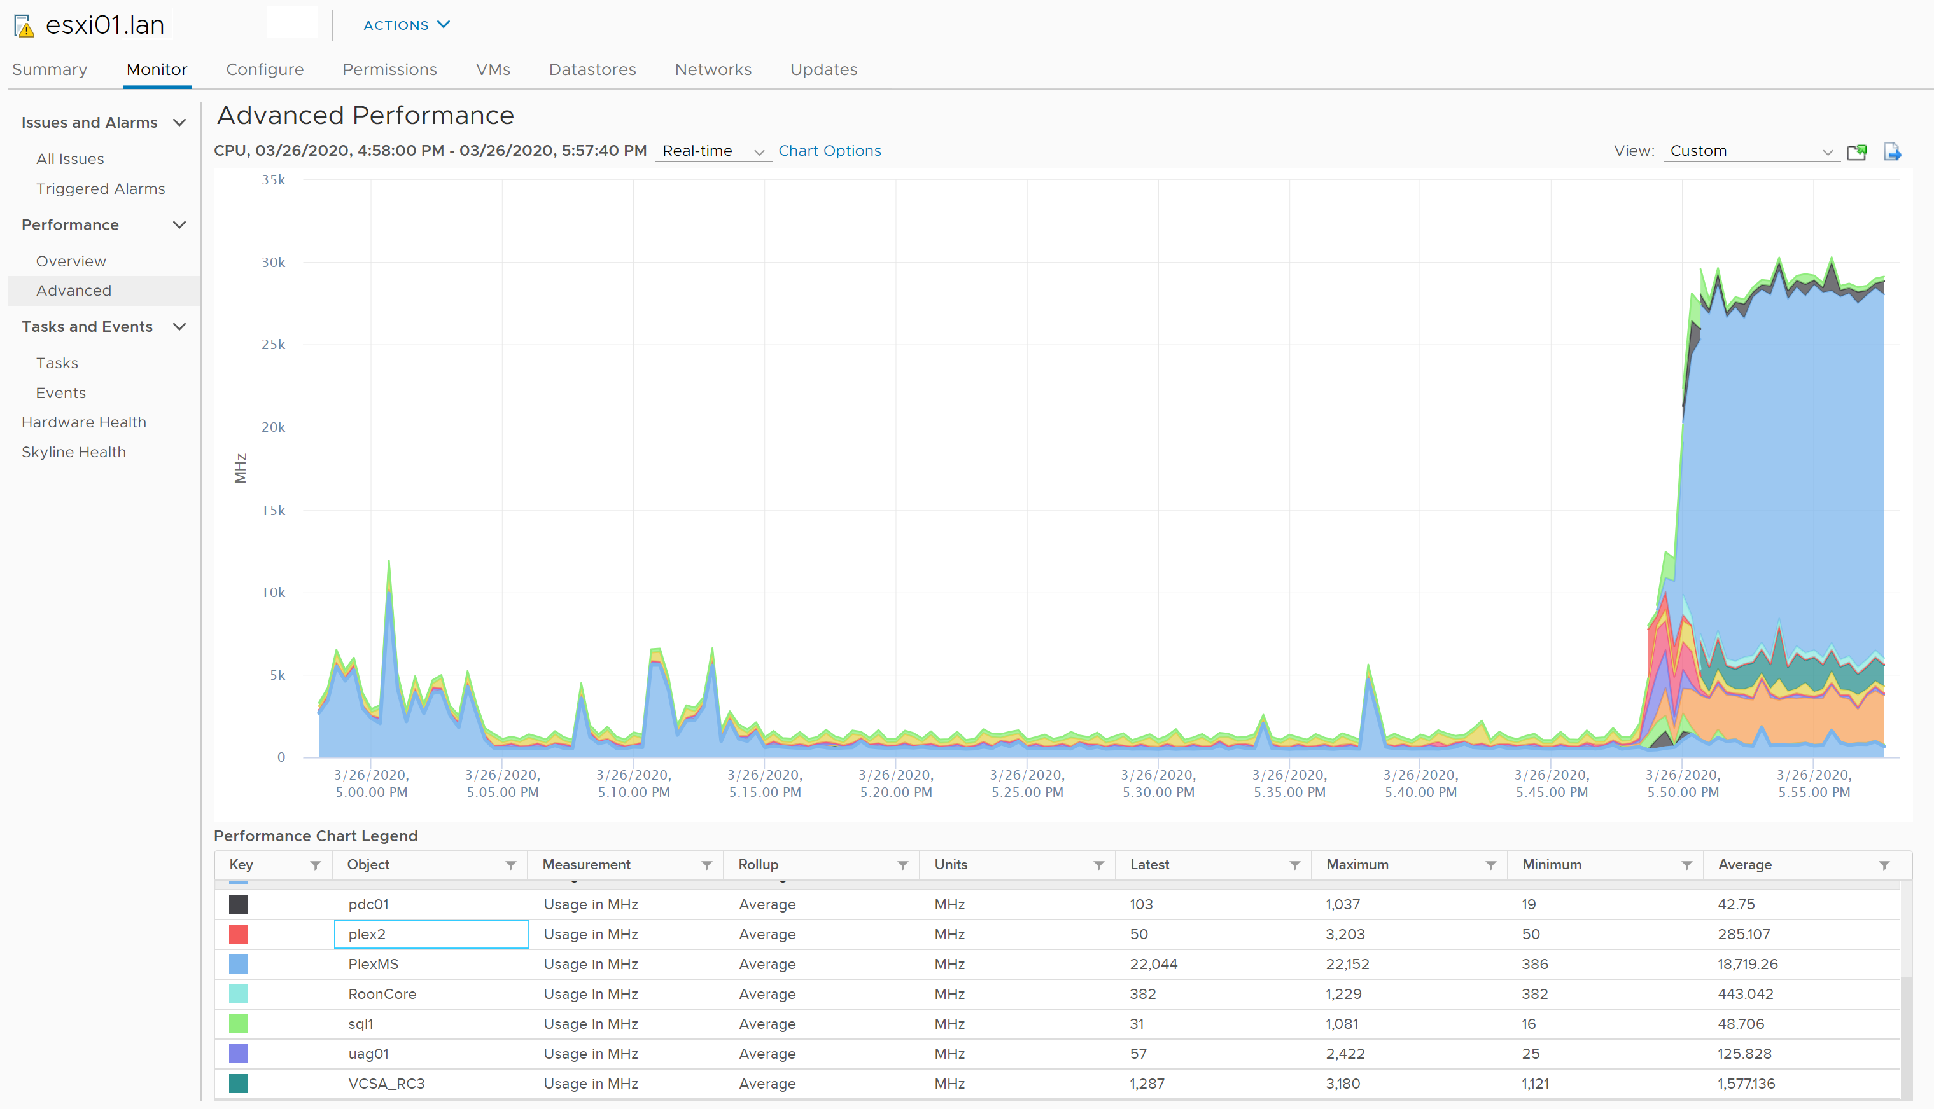
Chart Types: Stacked Per VM
Per-VM stacked graphs are available only for hosts.
Notes:
Stacked charts display metrics for the child objects that have the highest statistical values. All other objects are aggregated, and the sum value is displayed with the term Other. For example, a host’s stacked CPU usage chart displays CPU usage metrics for the five VMs on the host that are consuming the most CPU resources. The Other amount contains the total CPU usage of the remaining VMs. The metrics for the host itself are displayed in separate line charts. By default, the 10 child objects with the highest data counter values appear.

Slide 44
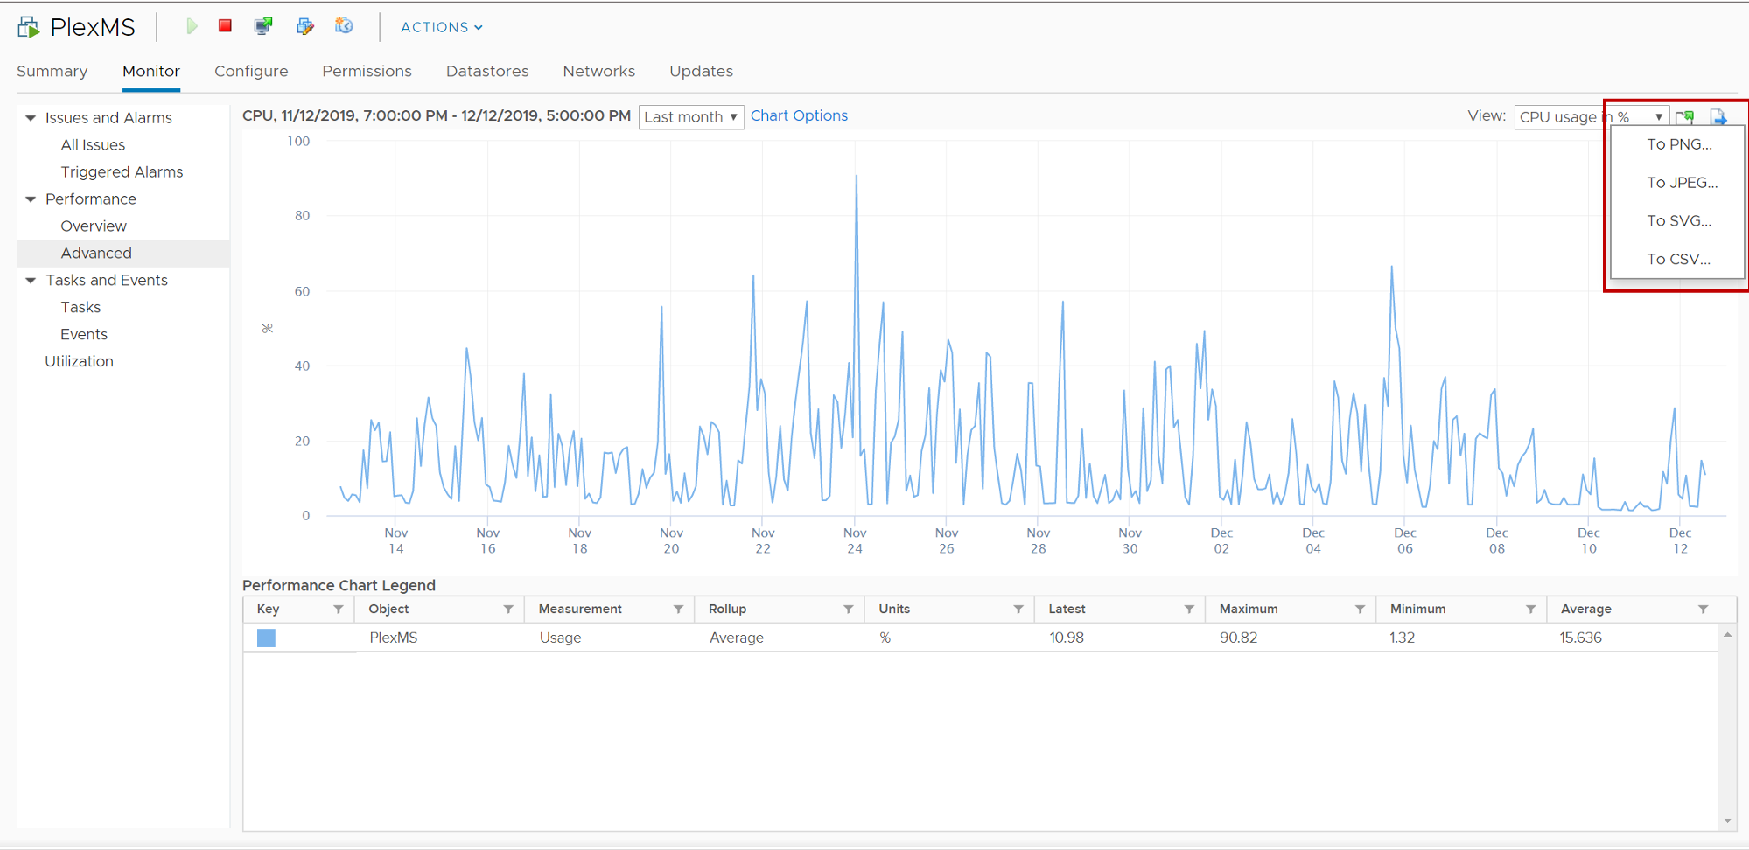
Saving Charts
You click the Save Chart icon above the graph to save performance chart information.
You can save information in PNG, JPEG, SVG, and CSV formats.
Notes:
In the vSphere Client, you can save data from the advanced performance charts to a file in various graphics formats or in Microsoft Excel format. When you save a chart, you select the file type and save the chart to the location of your choice.

Slide 45
About Objects and Counters
Performance charts graphically display CPU, memory, disk, network, and storage metrics for devices and entities managed by vCenter Server.
Objects are instances or aggregations of devices:
Examples:
vCPU0
vCPU1
vmhba1:1:2
Aggregation over all NICs
Counters identify which statistics to collect:
Examples:
CPU: Used time, ready time, usage (%)
NIC: Network packets received
Memory: Memory swapped
Notes:
In vCenter Server, you can determine how much or how little information about a specific device type is displayed. You can control the amount of information a chart displays by selecting one or more objects and counters.
An object refers to an instance for which a statistic is collected. For example, you might collect statistics for an individual CPU, all CPUs, a host, or a specific network device.
A counter represents the actual statistic that you are collecting. An example is the amount of CPU used or the number of network packets per second for a given device.

Slide 46
About Statistics Types
The statistics type is the unit of measurement that is used during the statistics interval.
Statistics Type | Description | Example
Rate | Value over the current interval | CPU use (MHz)
Delta | Change from previous interval | CPU ready time
Absolute | Absolute value, independent of interval | Memory active
Notes:
The statistics type refers to the measurement that is used during the statistics interval and is related to the unit of measurement.
The statistics type is one of the following:
Rate: Value over the current statistics interval
Delta: Change from the previous statistics interval
Absolute: Absolute value (independent of the statistics interval)
For example, CPU usage is a rate, CPU ready time is a delta, and memory active is an absolute value.

Slide 47
About Rollup
Rollup is the conversion function between statistics intervals:
5 minutes of past-hour statistics are converted to one past-day value:
Fifteen 20-second statistics are rolled up into a single value.
30 minutes of past-day statistics are converted to 1 past-week value:
Six 5-minute statistics are rolled up into a single value.
Rollup Type | Conversion Function | Sample Statistic
Average | Average of data points | CPU use (average)
Summation | Sum of data points | CPU ready time (milliseconds)
Latest | Last data point | Uptime (days)
Minimum | Current or average minimum data point | Available in all counters when vCenter Server statistics collection is set to level 4
Maximum | Current or average maximum data point
Notes:
Data is displayed at different specificities according to the historical interval. Past-hour statistics are shown at a 20-second specificity, and past-day statistics are shown at a 5-minute specificity. The averaging that is done to convert from one time interval to another is called rollup.
Different rollup types are available. The rollup type determines the type of statistical values returned for the counter:
Average: The data collected during the interval is aggregated and averaged.
Minimum: The minimum value is rolled up.
Maximum: The maximum value is rolled up.
The minimum and maximum values are collected and displayed only in collection level 4. Minimum and maximum rollup types are used to capture peaks in data during the interval. For real-time data, the value is the current minimum or current maximum. For historical data, the value is the average minimum or average maximum.
For example, the following information for the CPU usage chart shows that the average is collected at collection level 1 and that the minimum and maximum values are collected at collection level 4:
Counter: Usage
Unit: Percentage (%)
Rollup Type: Average (Minimum/Maximum)
Collection Level: 1 (4)
Statistics levels include summation and latest:
Summation: The collected data is summed. The measurement displayed in the performance chart represents the sum of data collected during the interval.
Latest: The data that is collected during the interval is a set value. The value displayed in the performance chart represents the current value.
For example, if you look at the CPU Used counter in a CPU performance chart, the rollup type is summation. So, for a given 5-minute interval, the sum of all the 20-second samples in that interval is represented.

Slide 48
Review of Learner Objectives
After completing this lesson, you should be able to meet the following objectives:
Describe the performance-tuning methodology
Identify resource-monitoring tools
Use vCenter Server performance charts to view performance

Slide 49
Lesson 4: Monitoring Resource Use

Slide 50
Learner Objectives
After completing this lesson, you should be able to meet the following objectives:
Monitor the key factors that can affect a virtual machine's performance
Use performance charts to view and improve performance

Slide 51
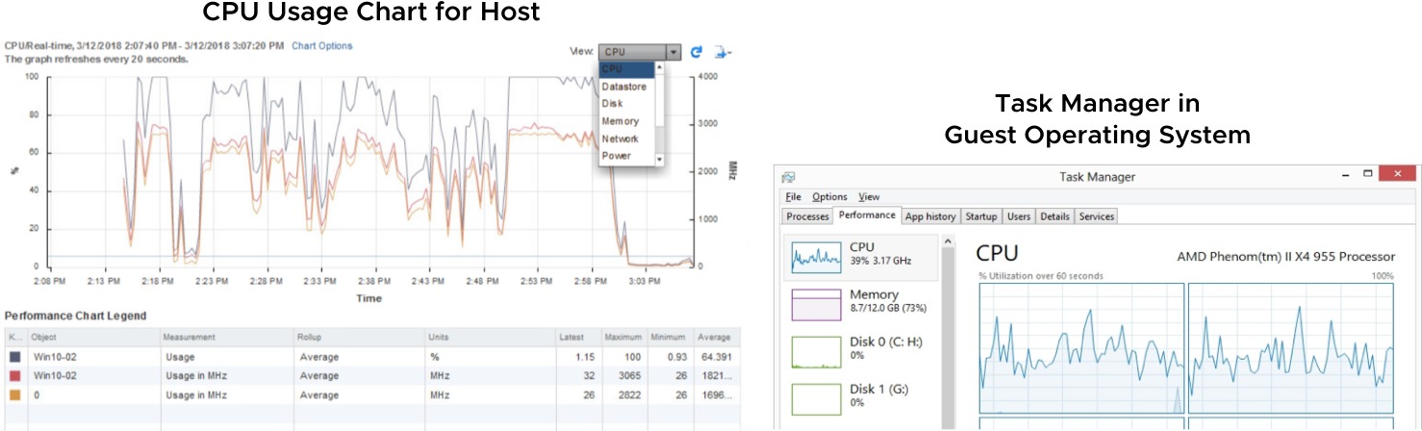
Interpreting Data from Tools
vCenter Server monitoring tools and guest OS monitoring tools provide different points of view.
Notes:
The key to interpreting performance data is to observe the range of data from the perspective of the guest operating system, the VM, and the host.
The CPU usage statistics in Task Manager, for example, do not give you the complete picture. View CPU usage for the VM and the host on which the VM is located. Use the performance charts in the vSphere Client to view this data.

Slide 52
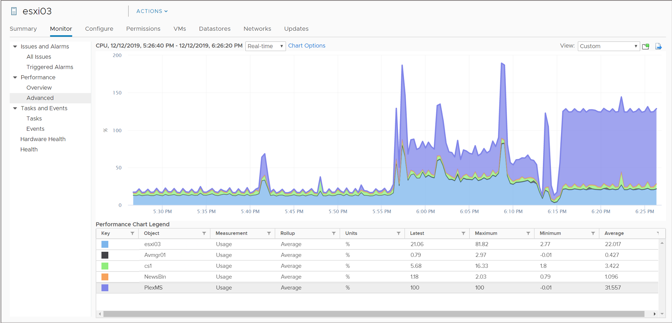
CPU-Constrained VMs (1)
If CPU use is continuously high, the VM is constrained by the CPU. However, the host might have enough CPU for other VMs to run.
Notes:
If CPU use is high, check the VM's CPU usage statistics. Use either the overview charts or the advanced charts to view CPU usage. The slide displays an advanced chart tracking a VM’s CPU usage.
If a VM’s CPU use remains high over a period of time, the VM is constrained by CPU. Other VMs on the host might have enough CPU resources to satisfy their needs.
If more than one VM is constrained by CPU, the key indicator is CPU ready time. Ready time refers to the interval when a VM is ready to execute instructions but cannot because it cannot get scheduled onto a CPU. Several factors affect the amount of ready time:
Overall CPU use: You are more likely to see ready time when use is high because the CPU is more likely to be busy when another VM becomes ready to run.
Number of resource consumers (in this case, guest operating systems): When a host is running a larger number of VMs, the scheduler is more likely to queue a VM behind VMs that are already running or queued.
A good ready time value varies from workload to workload. To find a good ready time value for your workload, collect ready time data over time for each VM. When you have this ready time data for each VM, estimate how much of the observed response time is ready time. If the shortfalls in meeting response-time targets for the applications appear largely because of the ready time, take steps to address the excessive ready time.

Slide 53
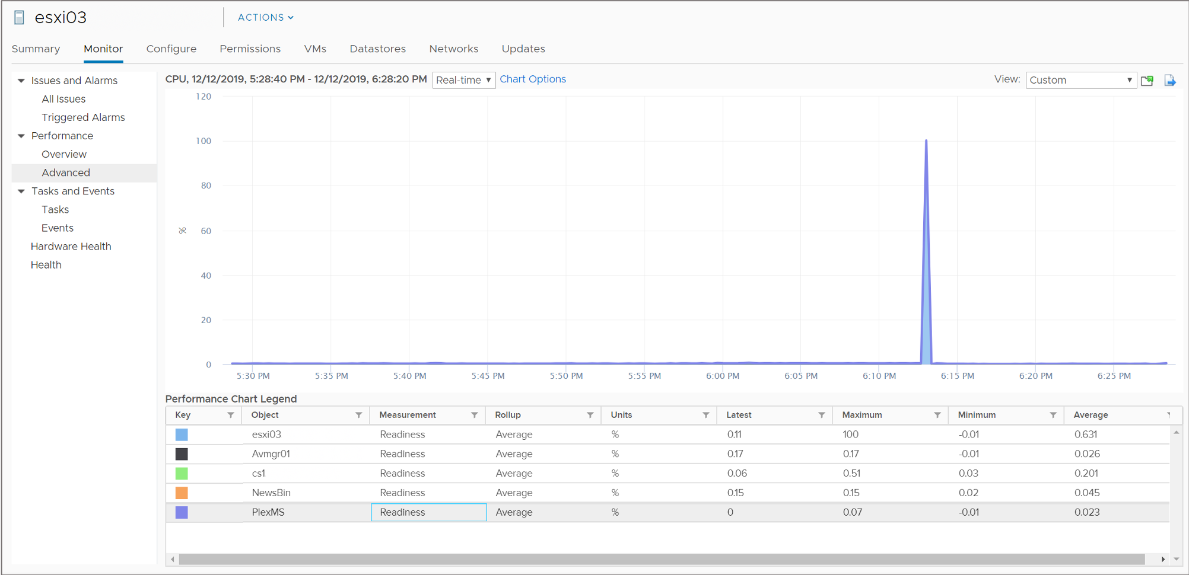
CPU-Constrained VMs (2)
Multiple VMs are constrained by the CPU if the following conditions are present:
High CPU usage in the guest operating system
Relatively high CPU readiness values for the VMs
Notes:
To determine whether a VM is being constrained by CPU resources, view CPU usage in the guest operating system using, for example, Task Manager.
If more than one VM is constrained by CPU, the key indicator is CPU readiness. CPU readiness is the percent of time that the VM cannot run because it is contending for access to the physical CPUs.
You are more likely to see readiness values when use is high because the CPU is more likely to be busy when another VM becomes ready to run. You are also more likely to see readiness values when a host is running many VMs. In this case, the scheduler is more likely to queue a VM behind VMs that are already running or queued.
A good readiness value varies from workload to workload.

Slide 54
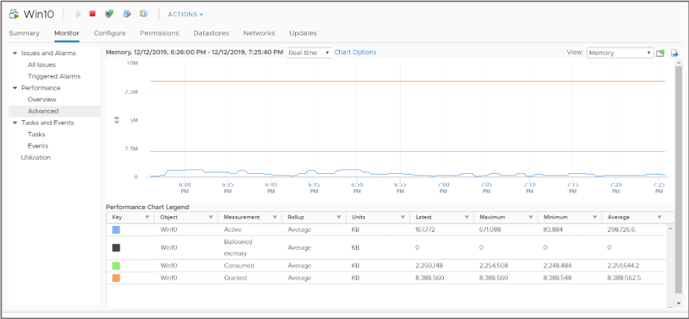
Memory-Constrained VMs (1)
Compare a VM's memory consumed and granted values to determine whether the VM is memory-constrained.

Slide 55
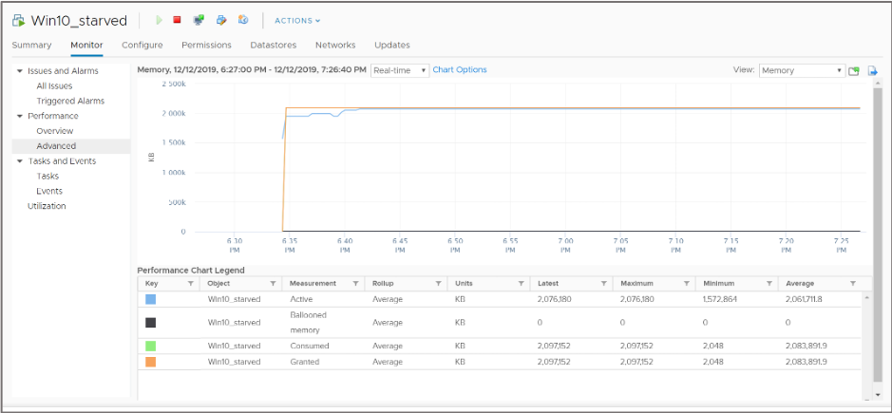
Memory-Constrained VMs (2)
If a VM consumes its entire memory allocation, the VM might be memory-constrained, and you should consider increasing the VM’s memory size.

Slide 56
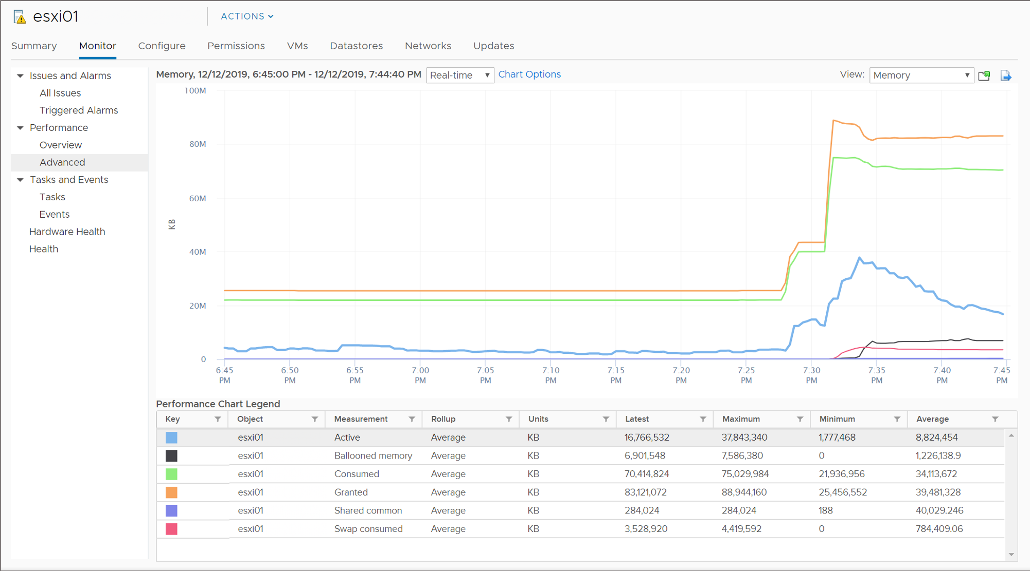
Memory-Constrained Hosts
Any evidence of ballooning or swapping is a sign that your host might be memory-constrained.
Notes:
You might see VMs with high ballooning activity and VMs being swapped in and out by the VMkernel. This serious situation indicates that the host memory is overcommitted and must be increased.

Slide 57
Disk-Constrained VMs
Disk-intensive applications can saturate the storage or the path.
If you suspect that a VM is constrained by disk access, take these actions:
Measure the throughput and latency between the VM and storage.
Use the advanced performance charts to monitor throughput and latency:
Read rate and write rate
Read latency and write latency
Notes:
Disk performance problems are commonly caused by saturating the underlying physical storage hardware. You can use the vCenter Server advanced performance charts to measure storage performance at different levels. These charts provide insight about a VM performance. You can monitor everything from the VM's datastore to a specific storage path.
If you select a host object, you can view throughput and latency for a datastore, a storage adapter, or a storage path. The storage adapter charts are available only for Fibre Channel storage. The storage path charts are available for Fibre Channel and iSCSI storage, not for NFS.
If you select a VM object, you can view throughput and latency for the VM’s datastore or specific virtual disk.
To monitor throughput, view the Read rate and Write rate counters. To monitor latency, view the Read latency and Write latency counters.

Slide 58
Monitoring Disk Latency
To determine disk performance problems, monitor two disk latency data counters:
Kernel command latency:
This counter is the average time that is spent in the VMkernel per SCSI command.
High numbers (greater than 2 milliseconds or 3 milliseconds) represent either an overworked array or an overworked host.
Physical device command latency:
This counter is the average time that the physical device takes to complete a SCSI command.
High numbers represent a slow or overworked array, for example:
For spinning disks (HDDs), greater than 15 milliseconds or 20 milliseconds
For SSDs, greater than 3 milliseconds or 4 milliseconds
Notes:
To determine whether your vSphere environment is experiencing disk problems, monitor the disk latency data counters. Use the advanced performance charts to view these statistics. In particular, monitor the following counters:
Kernel command latency: This data counter measures the average amount of time, in milliseconds, that the VMkernel spends processing each SCSI command. For best performance, the value should be 0 through 1 millisecond. If the value is greater than 4 milliseconds, the VMs on the ESXi host are trying to send more throughput to the storage system than the configuration supports.
Physical device command latency: This data counter measures the average amount of time, in milliseconds, for the physical device to complete a SCSI command.

Slide 59
Network-Constrained VMs
Network-intensive applications often bottleneck on path segments outside the ESXi host:
Example: WAN links between server and client
If you suspect that a VM is constrained by the network, take these actions:
Verify that VMware Tools is installed and that VMXNET3 is the virtual network adapter.
Measure the effective bandwidth between the VM and its peer system.
Check for dropped receive packets and dropped transmit packets.
Notes:
Like disk performance problems, network performance problems are commonly caused by saturating a network link between client and server. Use a tool such as Iometer, or a large file transfer, to measure the effective bandwidth.
Network performance depends on application workload and network configuration. Dropped network packets indicate a bottleneck in the network. To determine whether packets are being dropped, use the advanced performance charts to examine the droppedTx and droppedRx network counter values of a VM.
In general, the larger the network packets, the faster the network speed. When the packet size is large, fewer packets are transferred, which reduces the amount of CPU that is required to process the data. In some instances, large packets can result in high network latency. When network packets are small, more packets are transferred, but the network speed is slower because more CPU is required to process the data.

Slide 60
Lab 23: Monitoring Virtual Machine Performance
Use the system monitoring tools to review the CPU workload:
Create a CPU Workload
Use Performance Charts to Monitor CPU Use
Remove CPU Affinity and Change CPU Shares to Normal

Slide 61
Review of Learner Objectives
After completing this lesson, you should be able to meet the following objectives:
Monitor the key factors that can affect a virtual machine's performance
Use performance charts to view and improve performance

Slide 62
Lesson 5: Using Alarms

Slide 63
Learner Objectives
After completing this lesson, you should be able to meet the following objectives:
Use predefined alarms in vCenter Server
View and acknowledge alarms
Create custom alarms

Slide 64
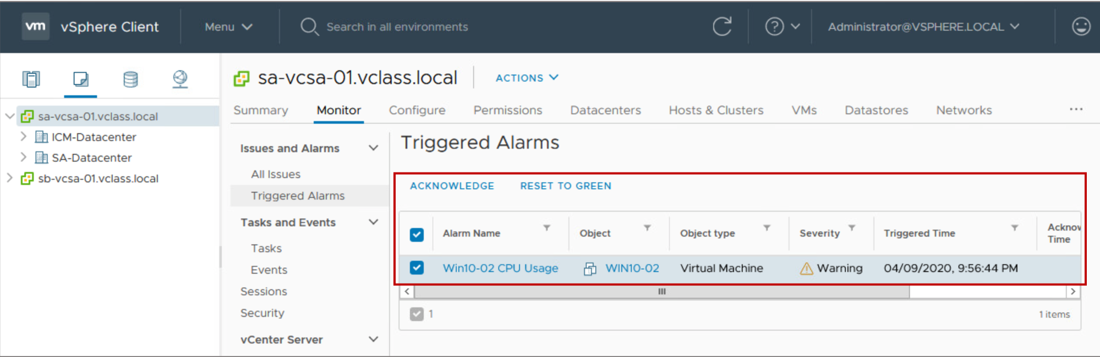
About Alarms
An alarm is a notification that is sent in response to an event or condition that occurs with an object in the inventory.
Notes:
You can acknowledge an alarm to let other users know that you take ownership of the issue. For example, a VM has an alarm set to monitor CPU use. The alarm is configured to send an email to an administrator when the alarm is triggered. The VM CPU use spikes, triggering the alarm, which sends an email to the administrator. The administrator acknowledges the triggered alarm to let other administrators know the problem is being addressed
After you acknowledge an alarm, the alarm actions are discontinued, but the alarm does not get cleared or reset when acknowledged. You reset the alarm manually in the vSphere Client to return the alarm to a normal state.

Slide 65
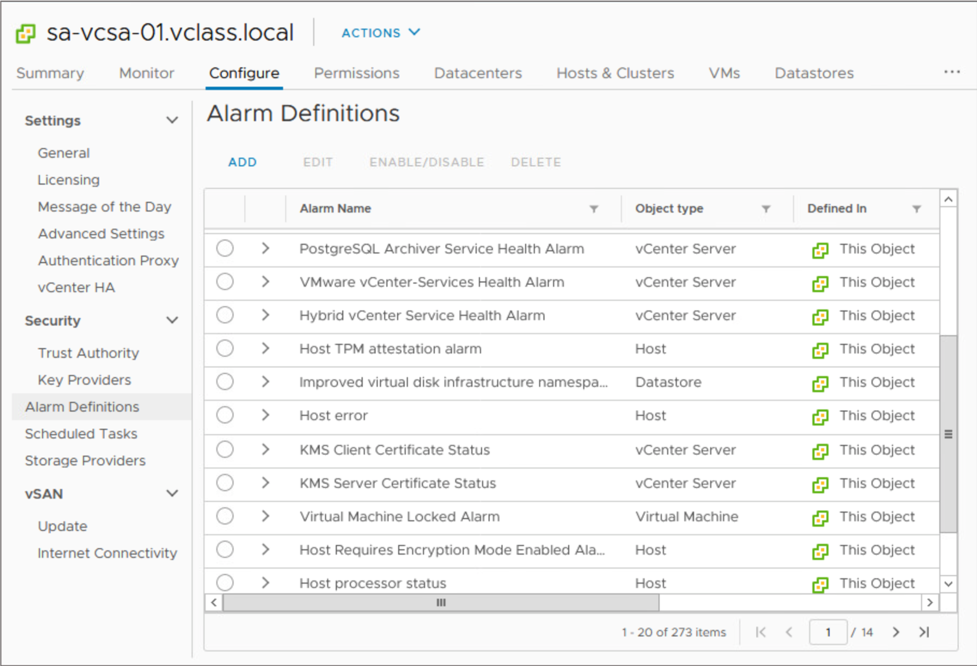
Predefined Alarms (1)
You can access many predefined alarms for various inventory objects, such as hosts, virtual machines, datastores, networks, and so on.

Slide 66
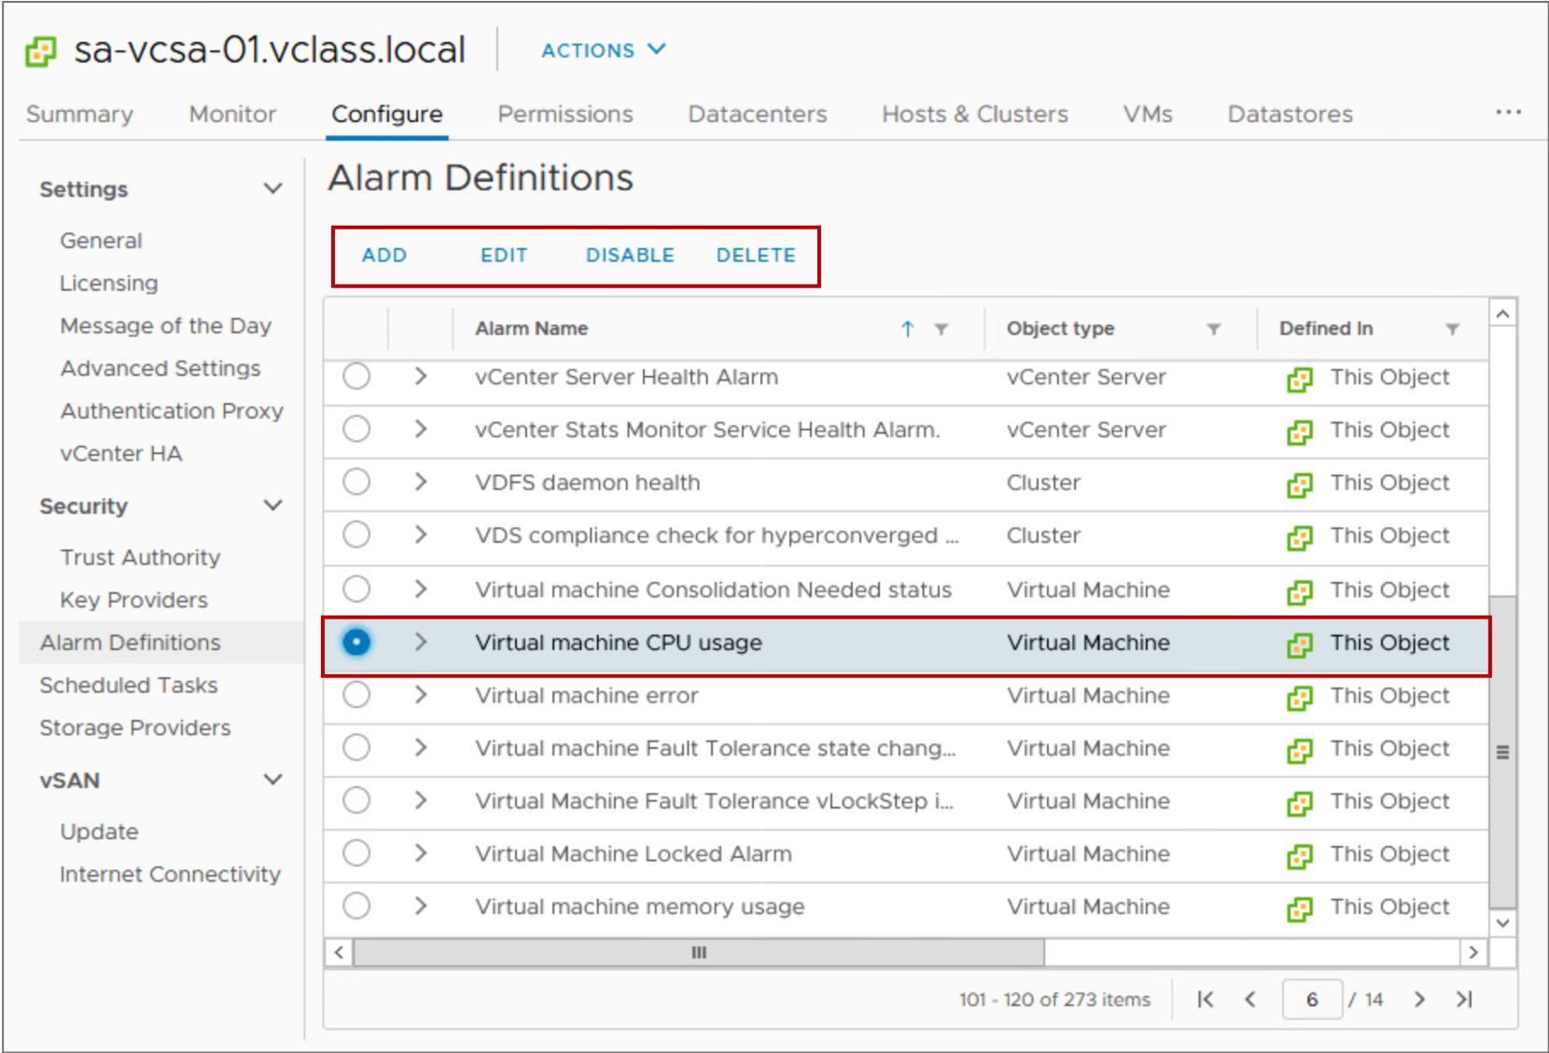
Predefined Alarms (2)
You can edit predefined alarms, or you can make a copy of an existing alarm and modify the settings as needed.
Notes:
To make a copy of an alarm, select the alarm and click ADD.

Slide 67
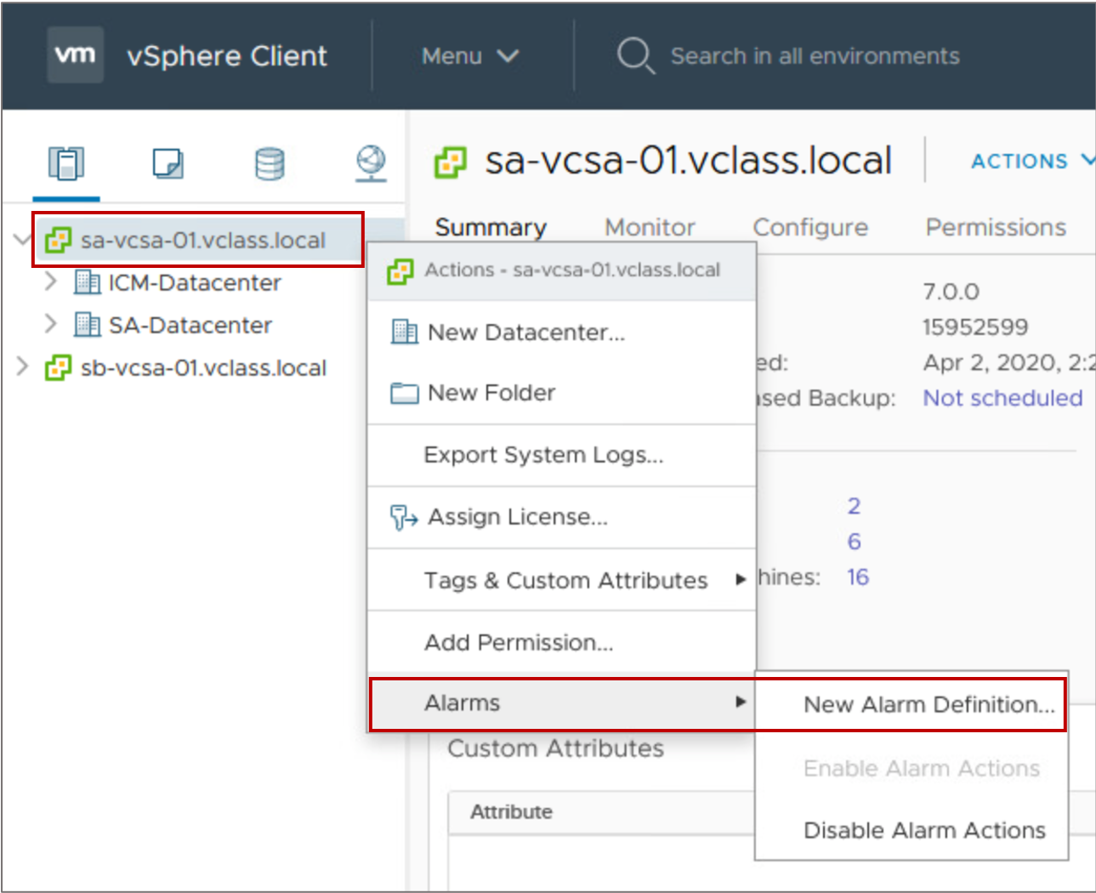
Creating a Custom Alarm
In addition to using predefined alarms, you can create custom alarms in the vSphere Client.
Notes:
If the predefined alarms do not address the event, state, or condition that you want to monitor, define custom alarm definitions instead of modifying predefined alarms.

Slide 68
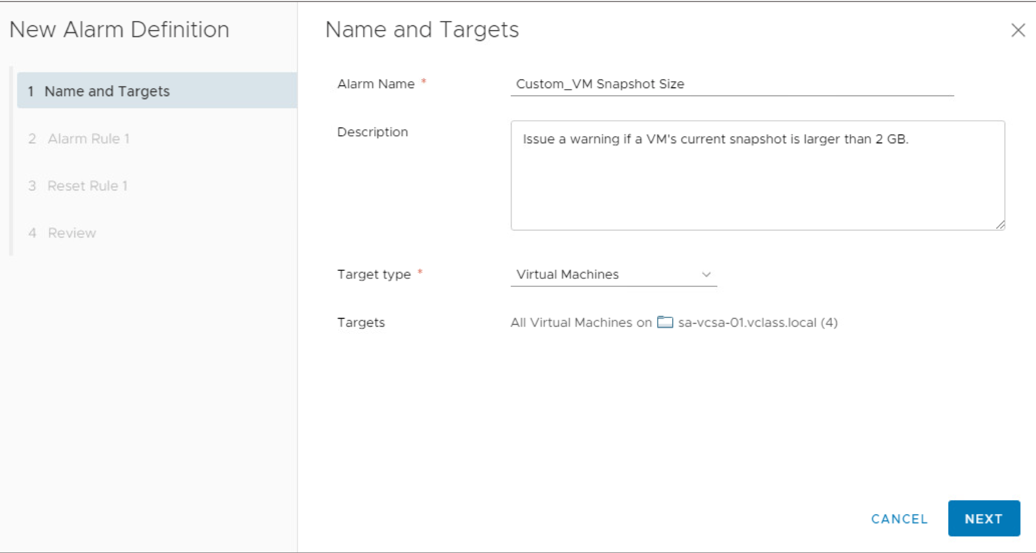
Defining the Alarm Target Type
On the Name and Targets page, you name the alarm, give it a description, and select the type of inventory object that this alarm monitors.
Notes:
You can create custom alarms for the following target types:
Virtual machines
Hosts, clusters, and data centers
Datastores and datastore clusters
Distributed switches and distributed port groups
vCenter Server

Slide 69
Defining the Alarm Rule: Trigger (1)
An alarm rule must contain at least one trigger.
A trigger can monitor the current condition or state of an object, for example:
A VM’s current snapshot is more than 2 GB.
A host is using 90 percent of its total memory.
A datastore is disconnected from all hosts.
A trigger can monitor events that occur in response to operations occurring on a managed object, for example:
The health of a host’s hardware changes.
A license expires in the data center.
A host leaves the distributed switch.
Notes:
You configure the alarm trigger to show as a warning or critical event when the specified criteria are met:
You can monitor the current condition or state of virtual machines, hosts, and datastores. Conditions or states include power states, connection states, and performance metrics such as CPU and disk use.
You can monitor events that occur in response to operations occurring with a managed object in the inventory or vCenter Server itself. For example, an event is recorded each time a VM (which is a managed object) is cloned, created, deleted, deployed, and migrated.

Slide 70
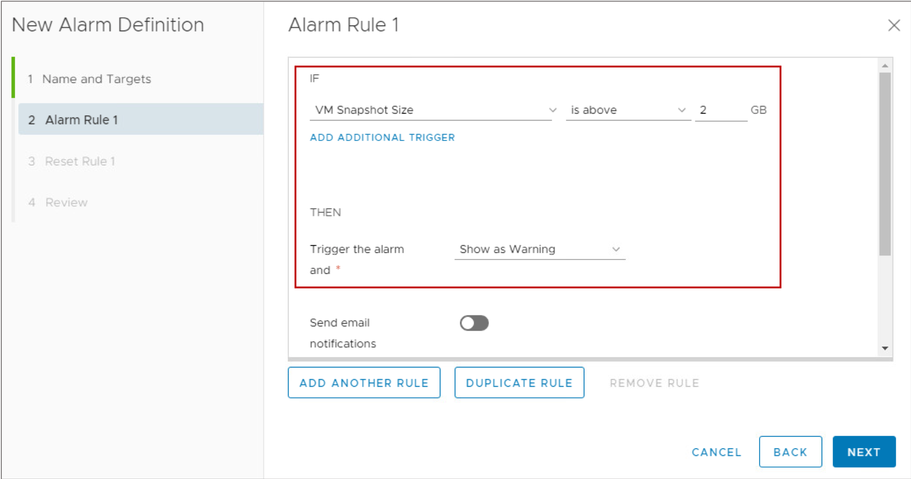
Defining the Alarm Rule: Trigger (2)
You select and configure the events, states, or conditions that trigger the alarm.
Notes:
You must create a separate alarm definition for each trigger. The OR operator is not supported in the vSphere Client. However, you can combine more than one condition trigger with the AND operator.

Slide 71
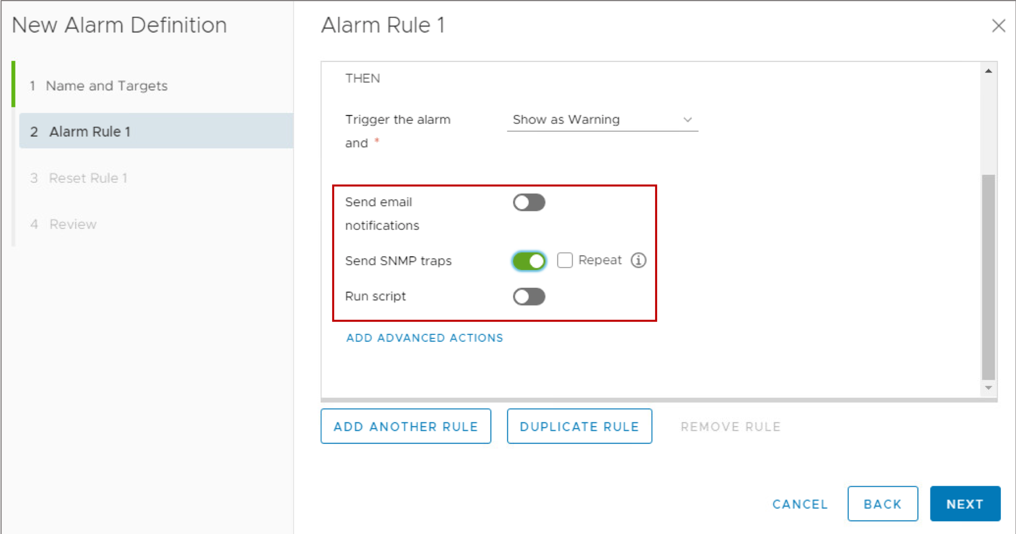
Defining the Alarm Rule: Setting the Notification
You configure the notification method to use when the alarm is triggered. The methods are sending an email, sending an SNMP trap, or running a script.

Slide 72
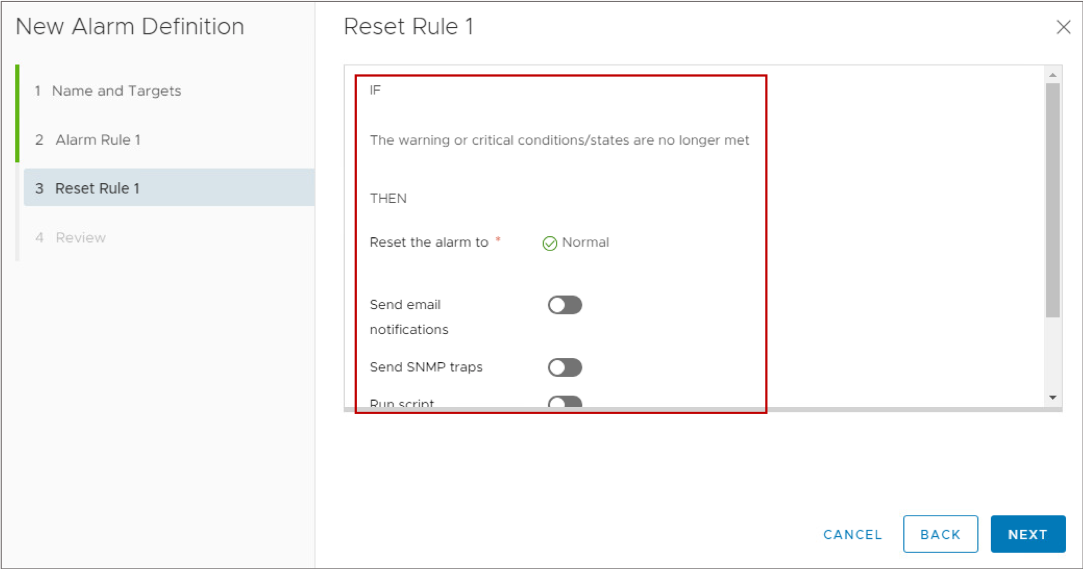
Defining the Alarm Reset Rules
You can select and configure the events, states, or conditions to reset the alarm to normal.
Sometimes, as in this example, you can access only one option to reset the alarm.

Slide 73
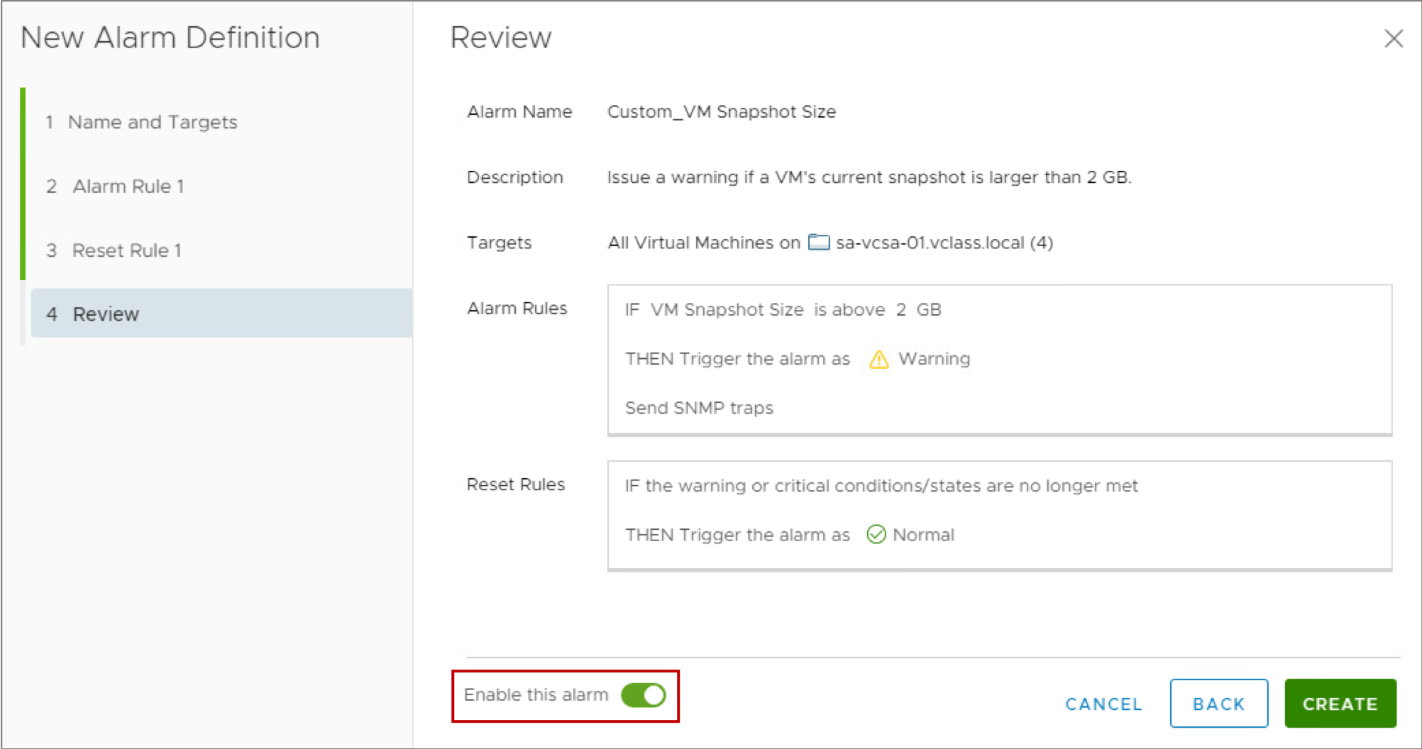
Enabling the Alarm
On the Review page, the new alarm definition is enabled by default.

Slide 74
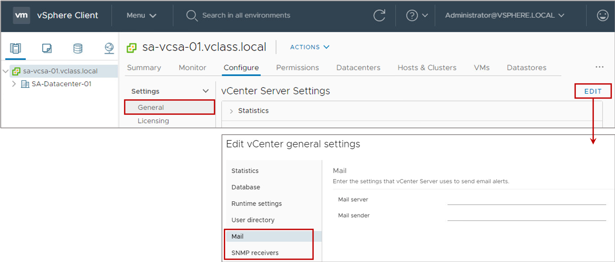
Configuring vCenter Server Notifications
If you use email or SNMP traps as the notification method, you must configure vCenter Server to support these notification methods.
Notes:
To configure email, specify the mail server FQDN or IP address and the email address of the sender account.
You can configure up to four receivers of SNMP traps. They must be configured in numerical order. Each SNMP trap requires a corresponding host name, port, and community.

Slide 75
Lab 24: Using Alarms
Create alarms to monitor virtual machine events and conditions:
Create a Virtual Machine Alarm to Monitor a Condition
Trigger the Virtual Machine Alarm
Create a Virtual Machine Alarm to Monitor an Event
Trigger the Virtual Machine Alarm
Disable Virtual Machine Alarms

Slide 76
Review of Learner Objectives
After completing this lesson, you should be able to meet the following objectives:
Use predefined alarms in vCenter Server
View and acknowledge alarms
Create custom alarms

Slide 77
Activity: Virtual Beans Resource Monitoring (1)
Which tools can Virtual Beans use to meet its goals for managing and monitoring the vSphere environment? Match each Virtual Beans requirement with the appropriate vSphere feature.
Virtual Beans Requirements
Increase compute resources for business-critical workloads, particularly during peak months.
Provide proactive recommendations to help avoid problems before they occur.
Create monthly reports, for management, that contain graphs of VM resource usage.
Be notified when ESXi hosts experience high CPU and memory usage.
vSphere Features
Alarms
Shares, limits, reservations
VMware Skyline
vCenter Server performance charts

Slide 78
Activity: Virtual Beans Resource Management and Monitoring (2)
Which tools can Virtual Beans use to meet its goals for managing and monitoring the vSphere environment? Match each Virtual Beans requirement with the appropriate vSphere feature.
Virtual Beans Requirement | vSphere Feature
Increase compute resources for business-critical workloads, particularly during peak months. | Shares, limits, and reservations
Provide proactive recommendations to help avoid problems before they occur. | VMware Skyline
Create monthly reports, for management, that contain graphs of VM resource usage. | vCenter Server performance charts
Be notified when ESXi hosts experience high CPU and memory usage. | Alarms

Slide 79
Key Points
An ESXi host uses memory overcommit techniques to allow the overcommitment of memory while possibly avoiding the need to page memory out to disk.
The VMkernel balances processor time to guarantee that the load is spread smoothly across processor cores in the system.
You can apply reservations, limits, and shares against a VM to control the amount of CPU and memory resources granted.
The key to interpreting performance data is to observe the range of data from the perspective of the guest operating system, the virtual machine, and the host.
You use alarms to monitor the vCenter Server inventory objects and send notifications when selected events or conditions occur.
Questions?

